Slide 1
Networks & Health
Intro & overview
Dropbox:
https://tinyurl.com/SN-H2018

Slide 2
Social Network Data
Outline
Intro/Big Picture
What are networks?
Connections & Positions
Network Relevance to Health Research
Basic Network Data Elements
Types of networks
Levels of analysis
Data structures

Slide 3
Introduction
We live in a connected world:
“To speak of social life is to speak of the association between people – their associating in work and in play, in love and in war, to trade or to worship, to help or to hinder. It is in the social relations men establish that their interests find expression and their desires become realized.”
Peter M. Blau
Exchange and Power in Social Life, 1964

Slide 4
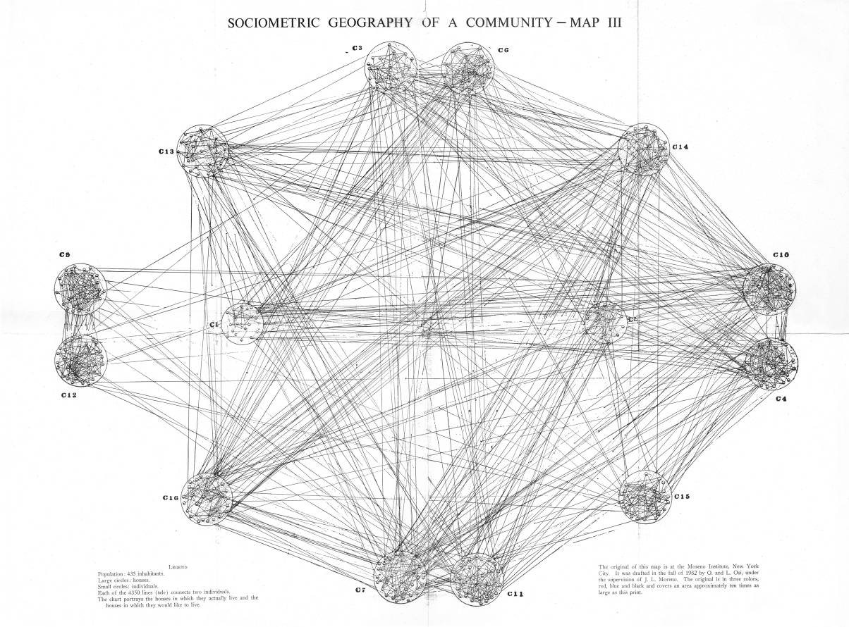
Introduction
We live in a connected world:
*
"If we ever get to the point of charting a whole city or a whole nation, we would have … a picture of a vast solar system of intangible structures, powerfully influencing conduct, as gravitation does in space. Such an invisible structure underlies society and has its influence in determining the conduct of society as a whole."
J.L. Moreno, New York Times, April 13, 1933
*1934, NYTime. Moreno claims this work was covered in “all the major papers” but I can’t find any other clips…
Notes:
Moreno claimed authorship of the idea; citing no real inspiration other than his own creativity. But graph theory has been going since 1740s, kinship diagrams since at least the 1870s, org charts from the 1920s, etc. So he’s not operating in a vacuum.

Slide 5
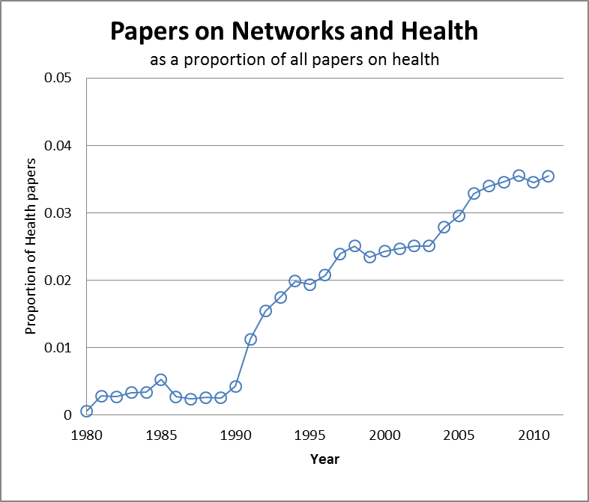
Introduction
But scientists are starting to take network seriously:
“Networks”

Slide 6
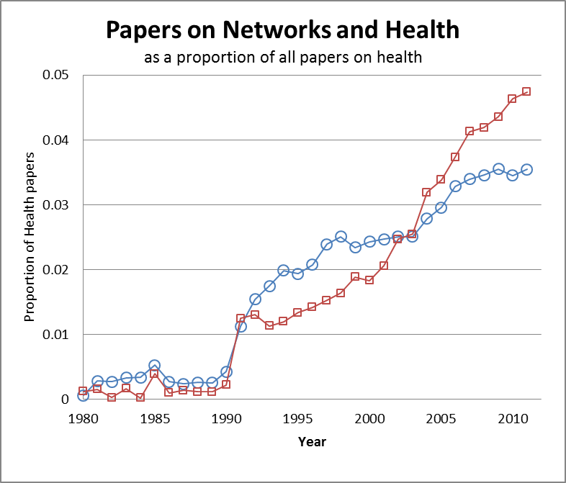
Introduction
But scientists are starting to take network seriously: why?
“Obesity”
“Networks”

Slide 7
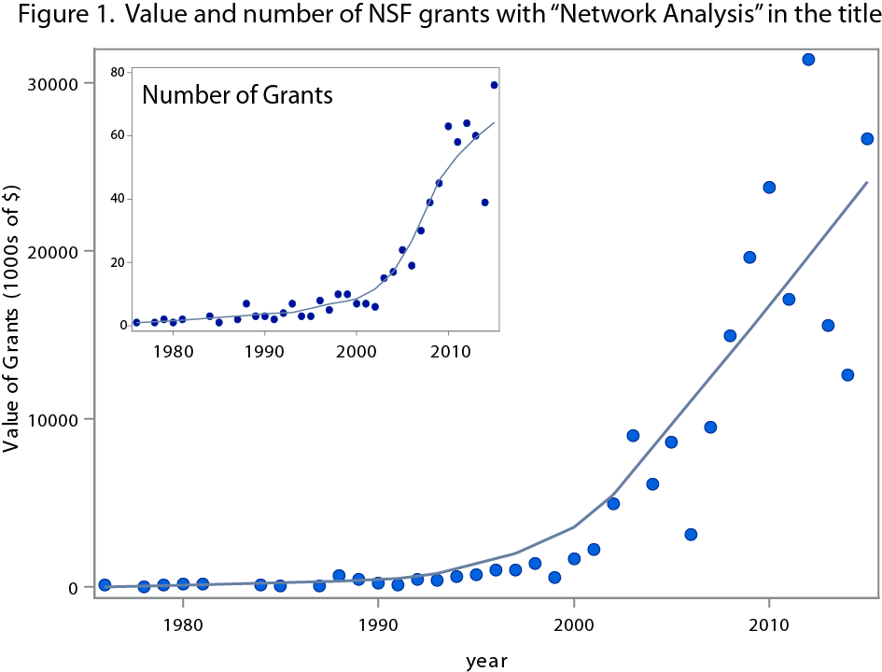
Introduction
…and NSF is investing heavily in it.

Slide 8




Introduction
High Schools as Networks

Slide 9
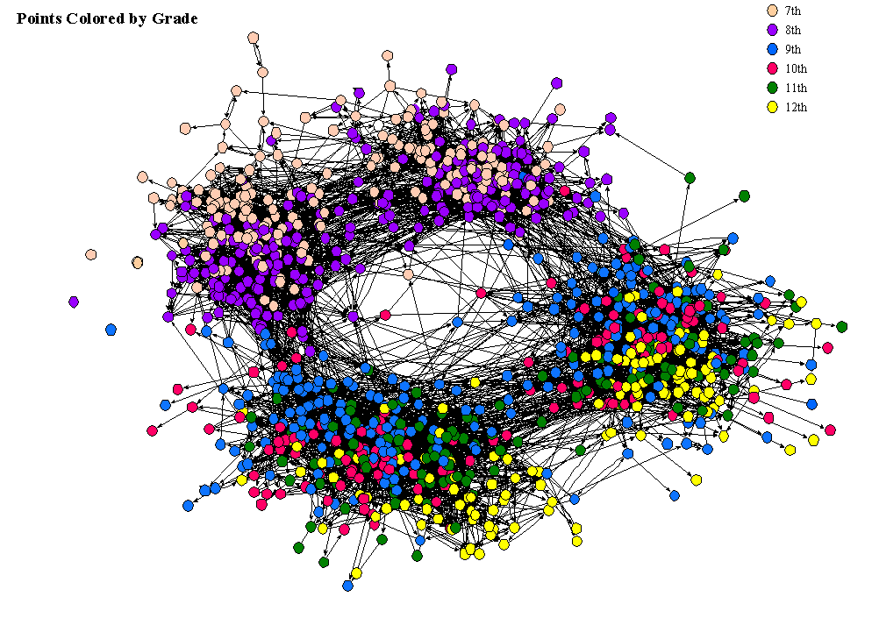
Introduction
Countryside High School, by grade

Slide 10
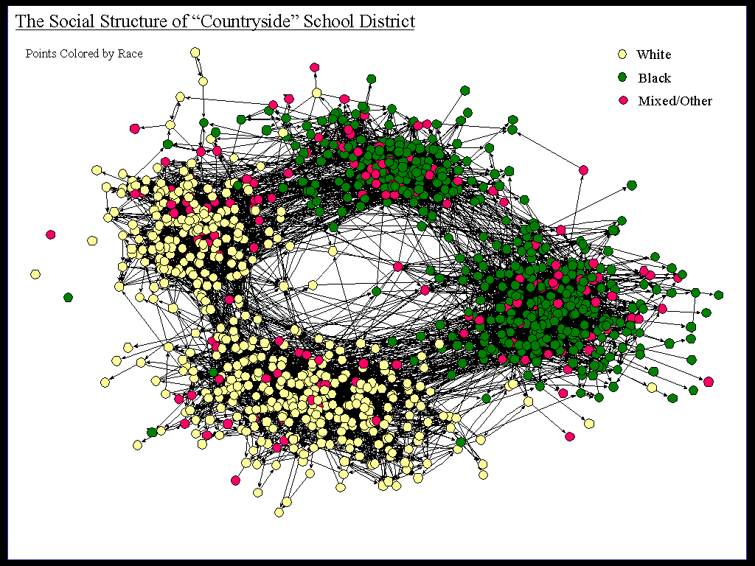
Introduction
Countryside High School, by race

Slide 11
Introduction
And yet, standard social science analysis methods do not take this space into account.
“For the last thirty years, empirical social research has been dominated by the sample survey. But as usually practiced, …, the survey is a sociological meat grinder, tearing the individual from his social context and guaranteeing that nobody in the study interacts with anyone else in it.”
Allen Barton, 1968 (Quoted in Freeman 2004)
Moreover, the complexity of the relational world makes it impossible to identify social connectivity using only our intuition.
Social Network Analysis (SNA) provides a set of tools to empirically extend our theoretical intuition of the patterns that compose social structure.

Slide 12
Introduction
Social network analysis is:
a set of relational methods for systematically understanding and identifying connections among actors. SNA
is motivated by a structural intuition based on ties linking social actors
is grounded in systematic empirical data
draws heavily on graphic imagery
relies on the use of mathematical and/or computational models.
Social Network Analysis embodies a range of theories relating types of observable social spaces and their relation to individual and group behavior.

Slide 13
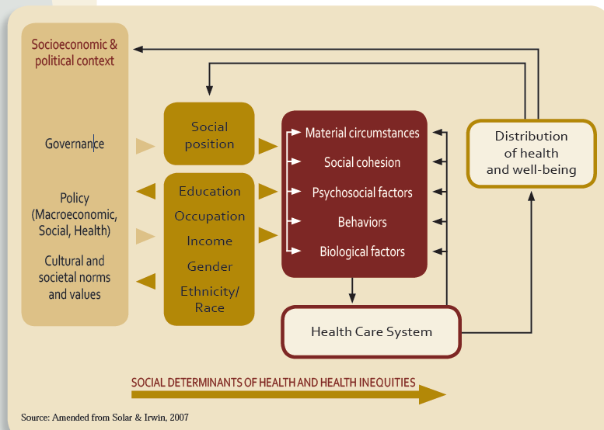

Introduction
Social Determinants of Health
“…social determinants of health refers to the complex, integrated, and overlapping social structures and economic systems that include social and physical environments and health services.” (CDC, 2010)
WHO Commission on Social Determinants of Health Conceptual Framework

Slide 14
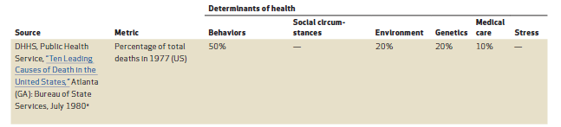
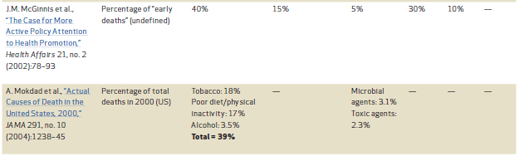
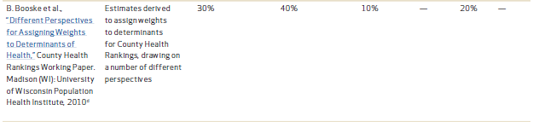
Introduction
Social Determinants of Health
Social factors matter
RWJ, Health Affairs (2014) “The relative contributions of multiple determinants to health outcomes”

Slide 15
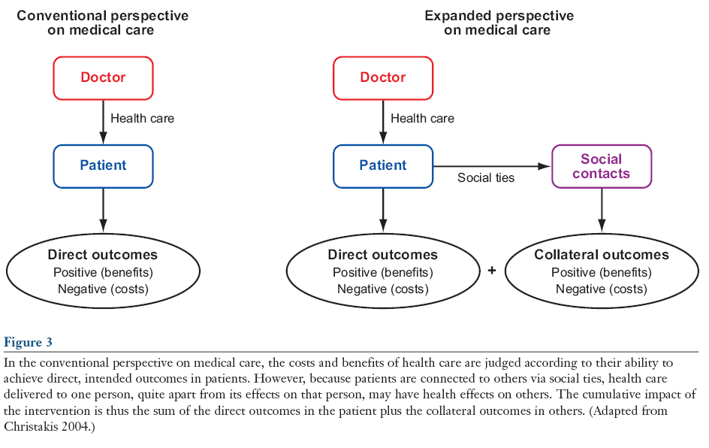
Introduction
Social Determinants of Health
Social effects hold promising multiplier effects:

Slide 16
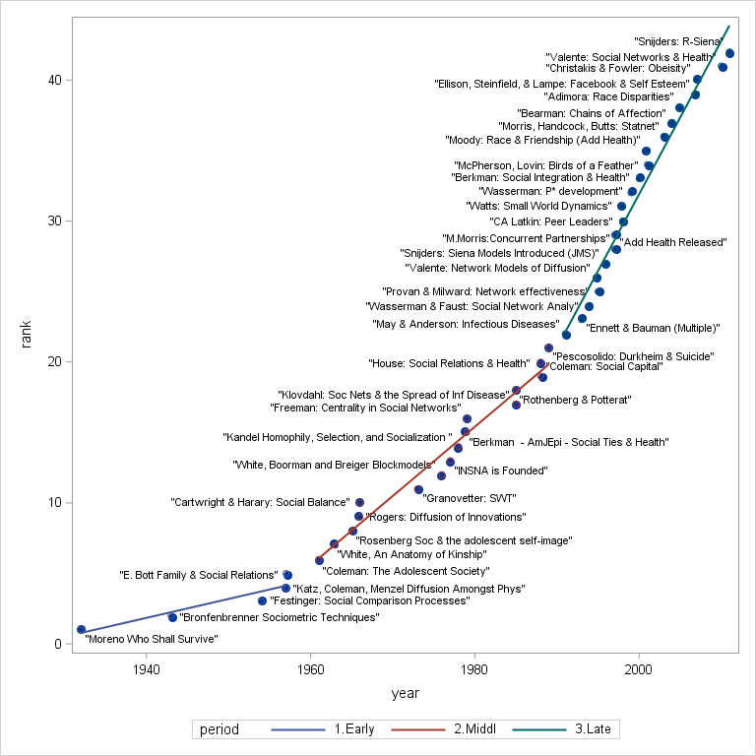
History of SN&H

Slide 17
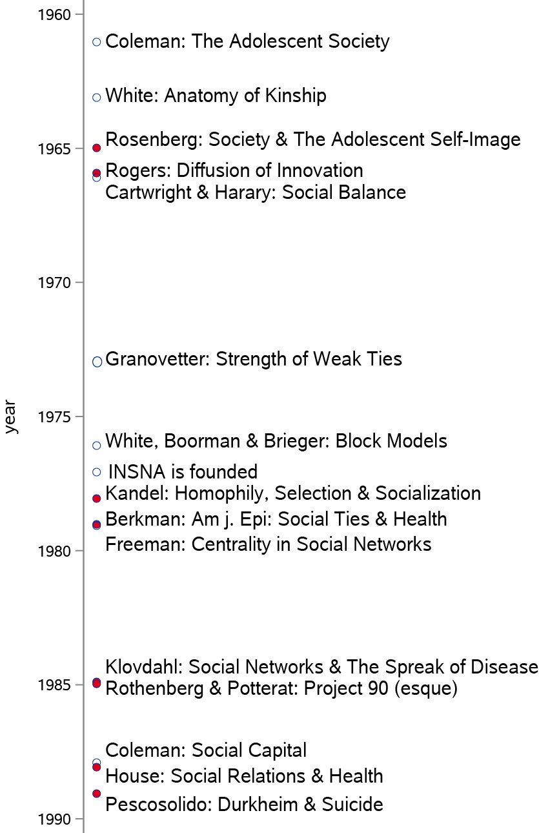


Slide 18


Slide 19
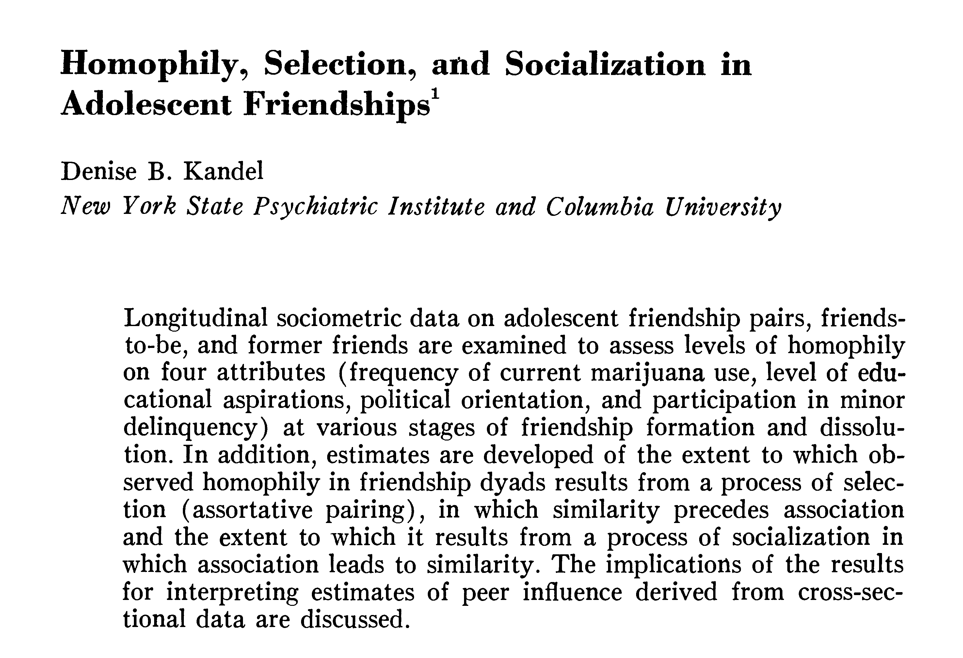

Slide 20
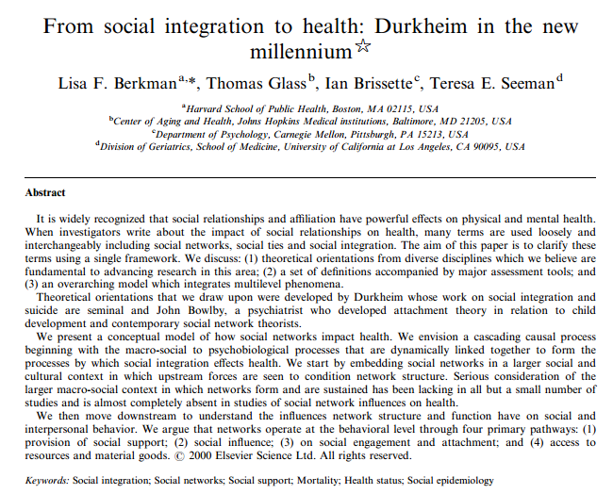
Social Science & Medicine, 2000

Slide 21
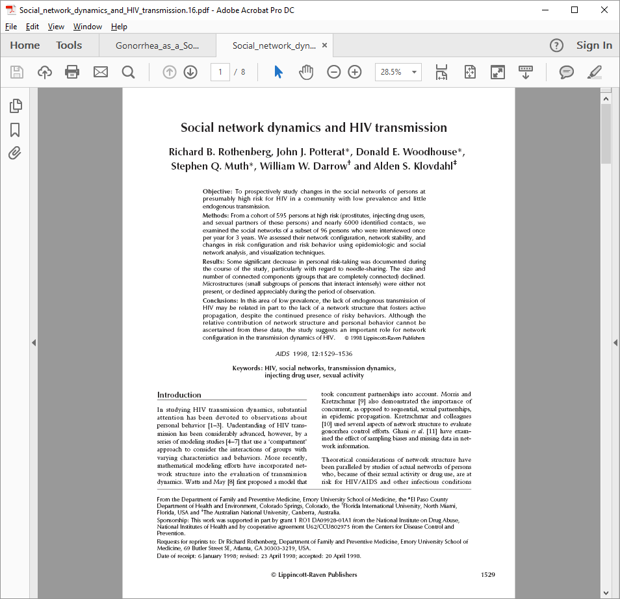
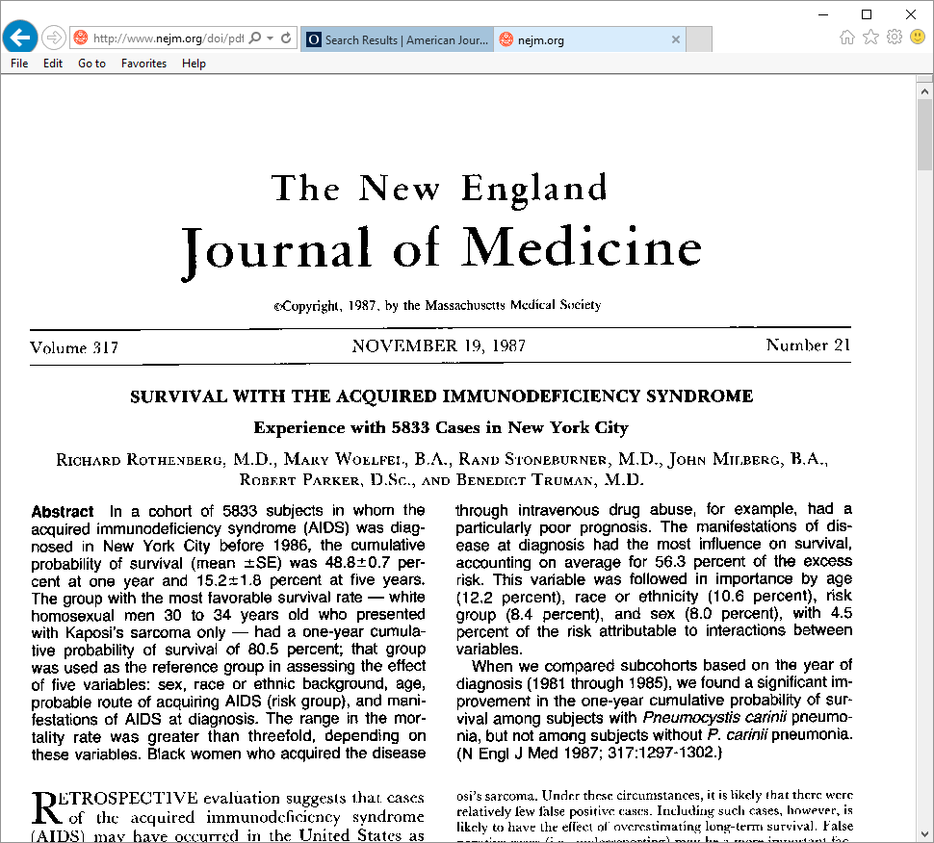
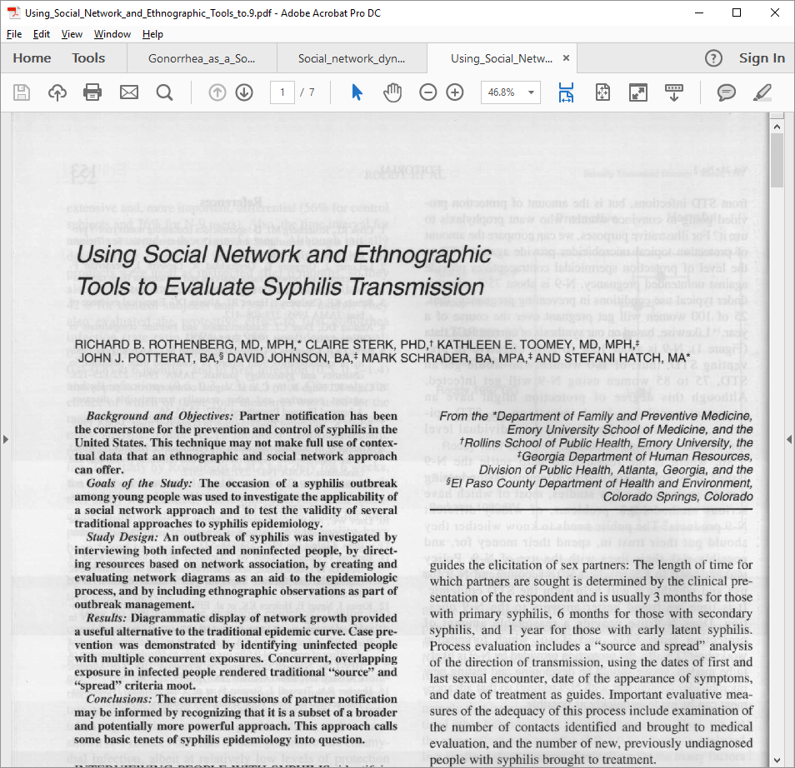

Slide 22


Slide 23
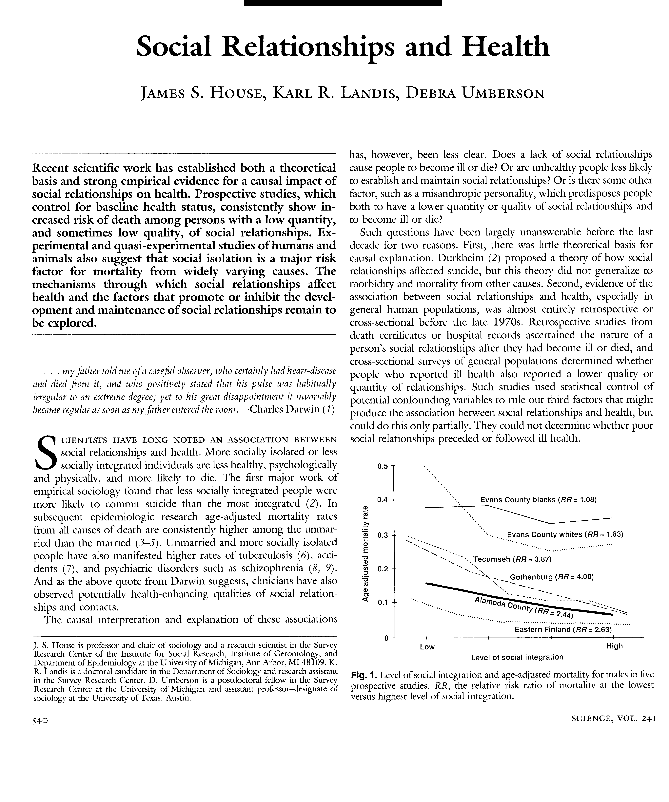

Slide 24


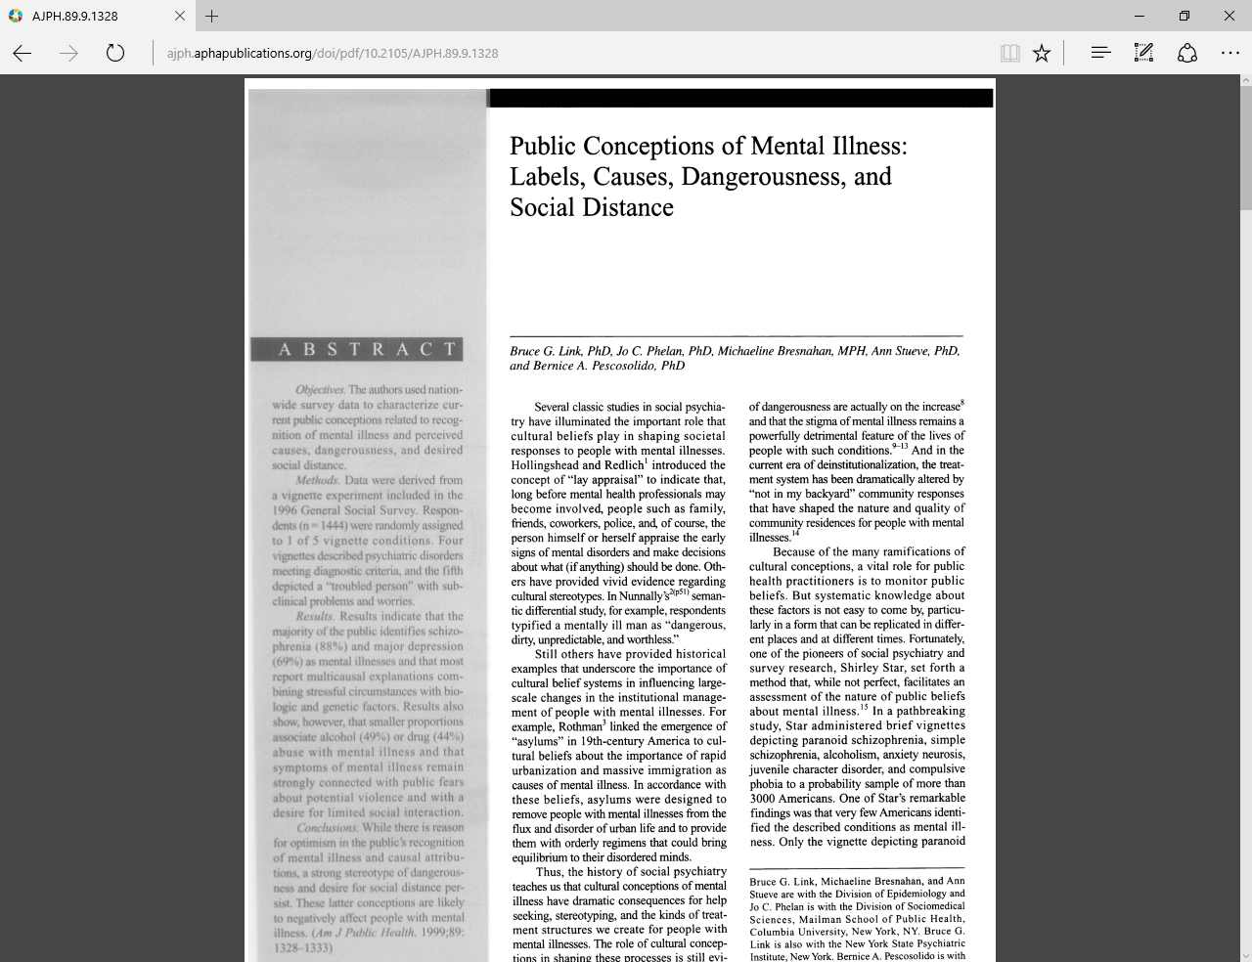
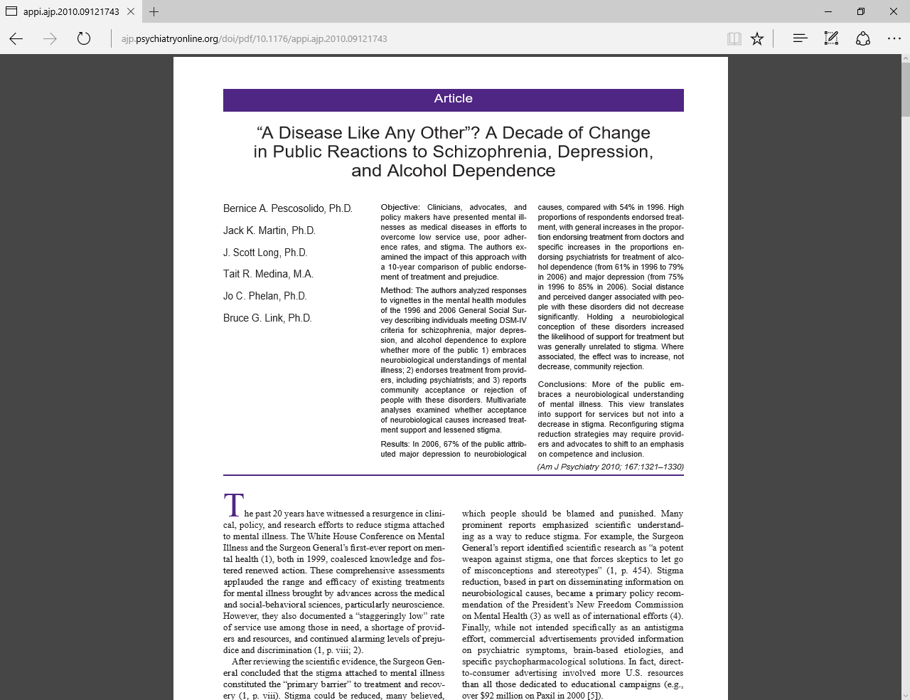
ASR
AJS
AJPH

Slide 25
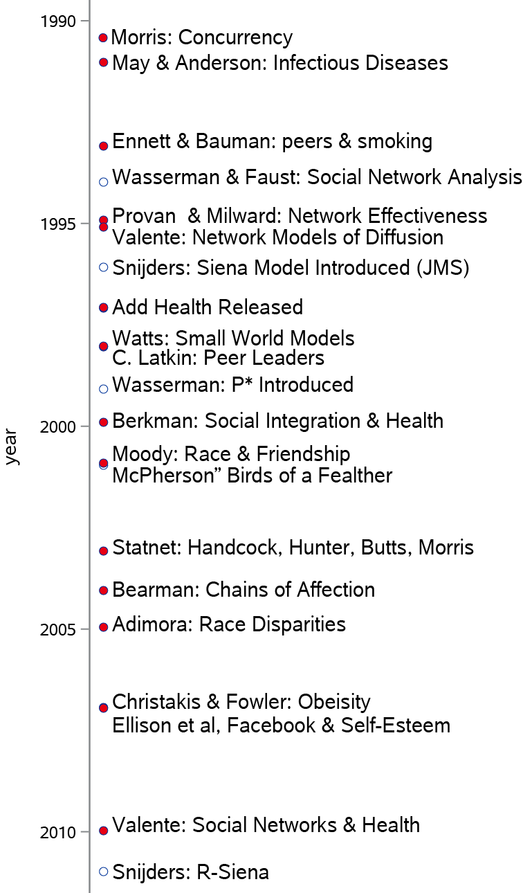
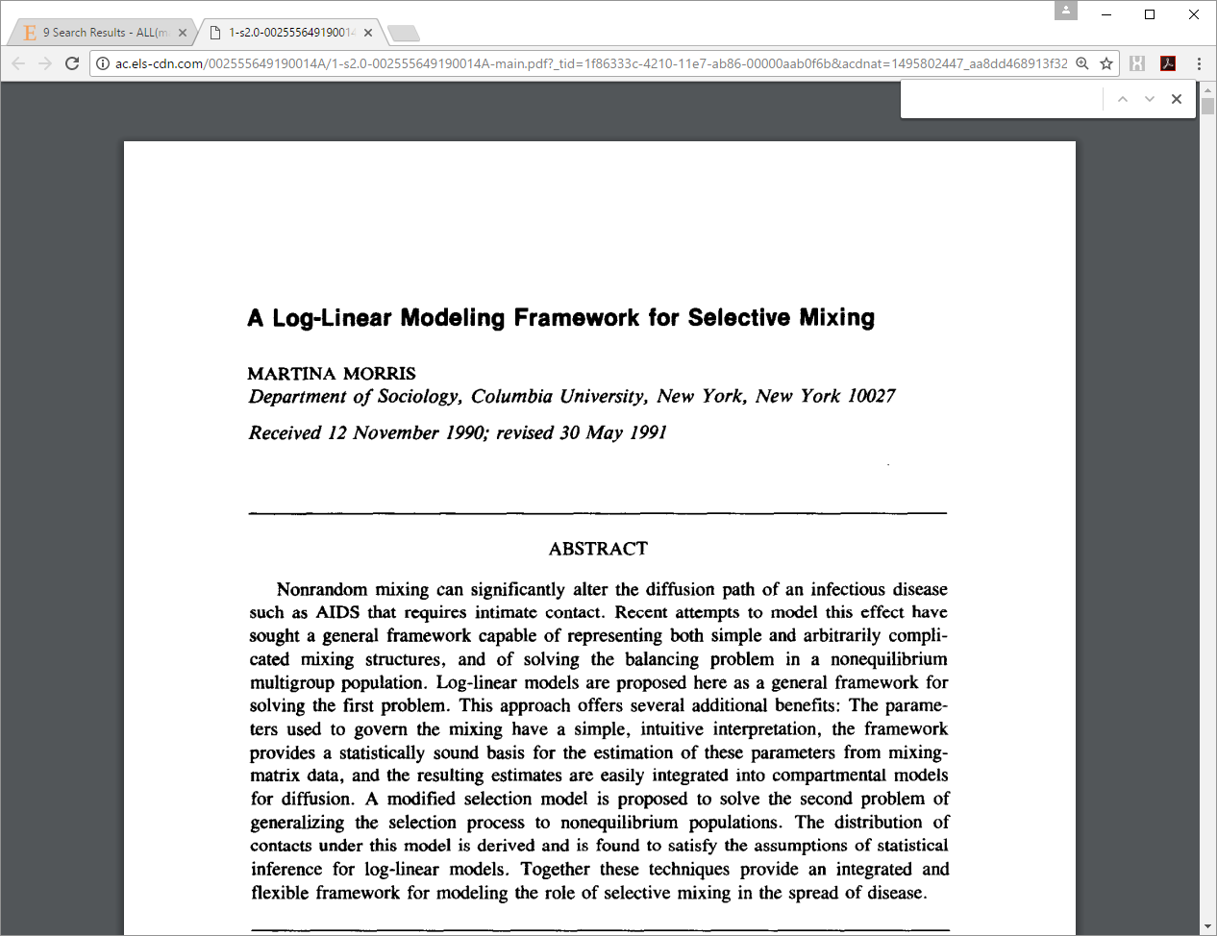
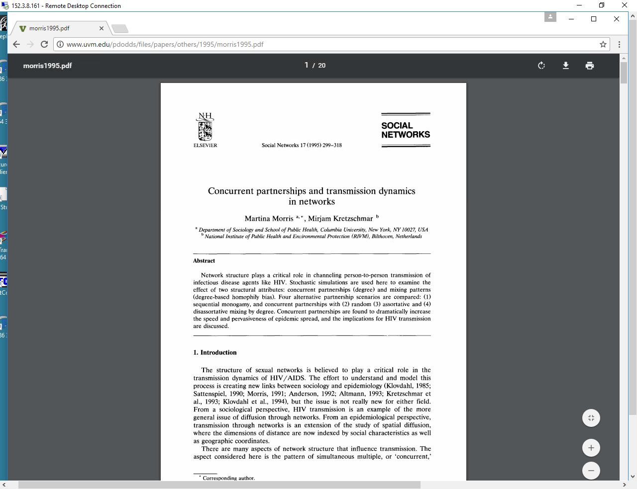
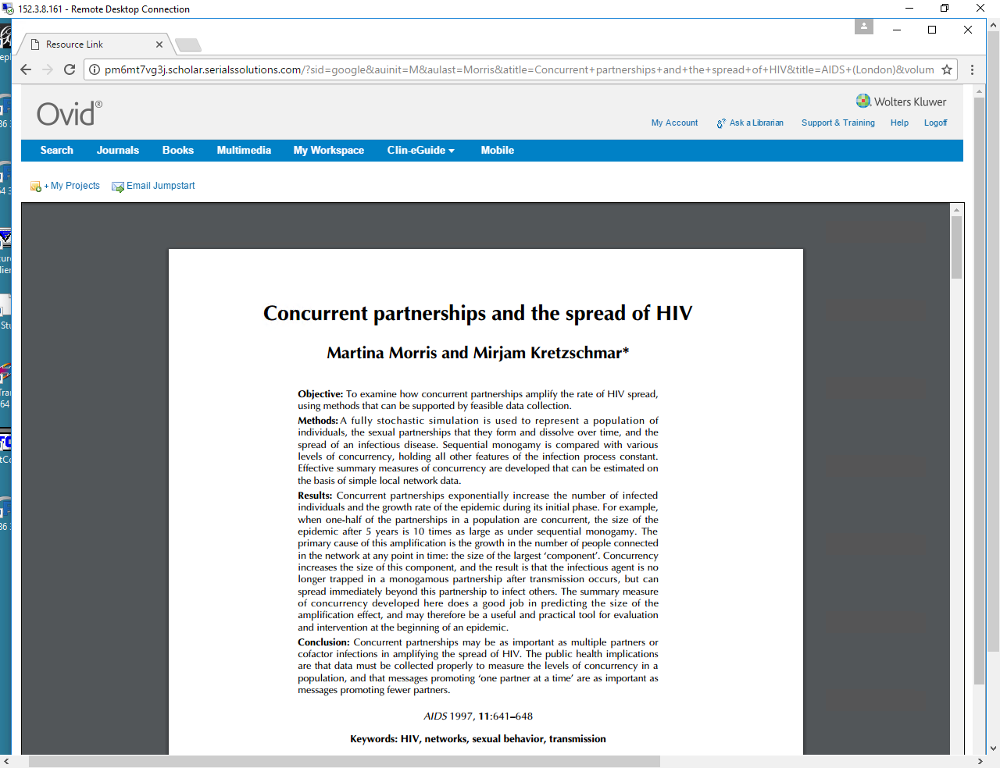

Slide 26


Slide 27
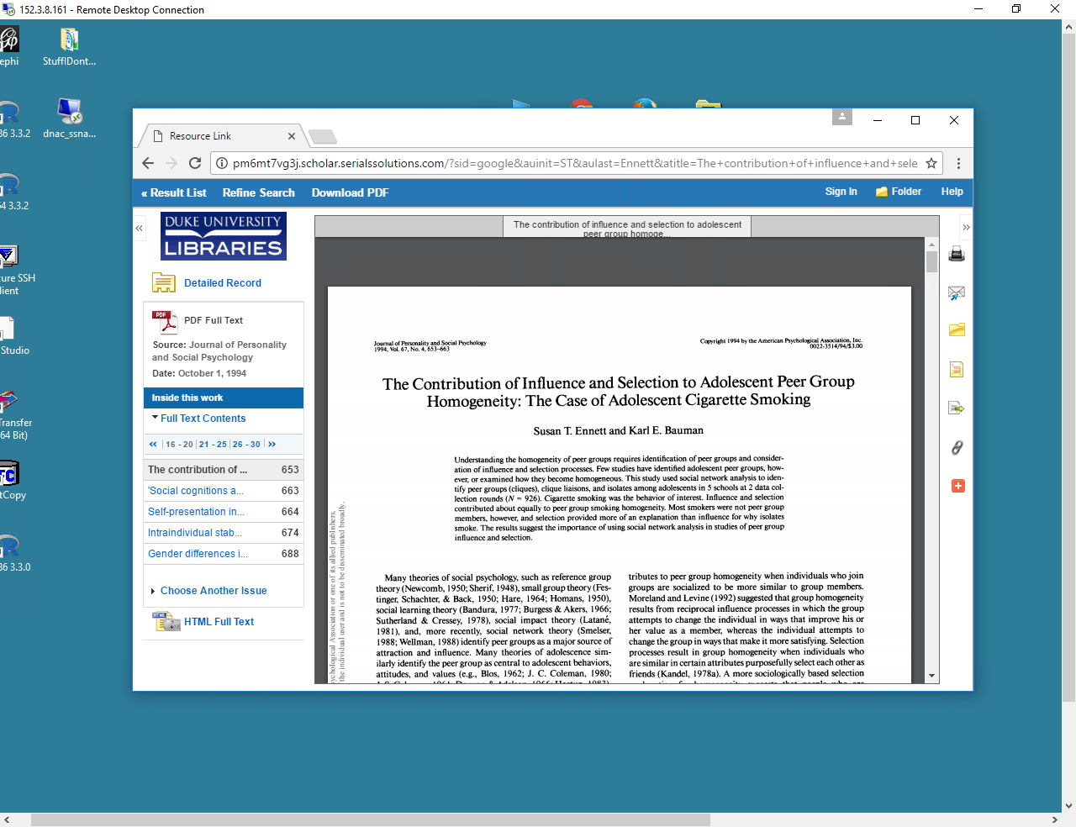
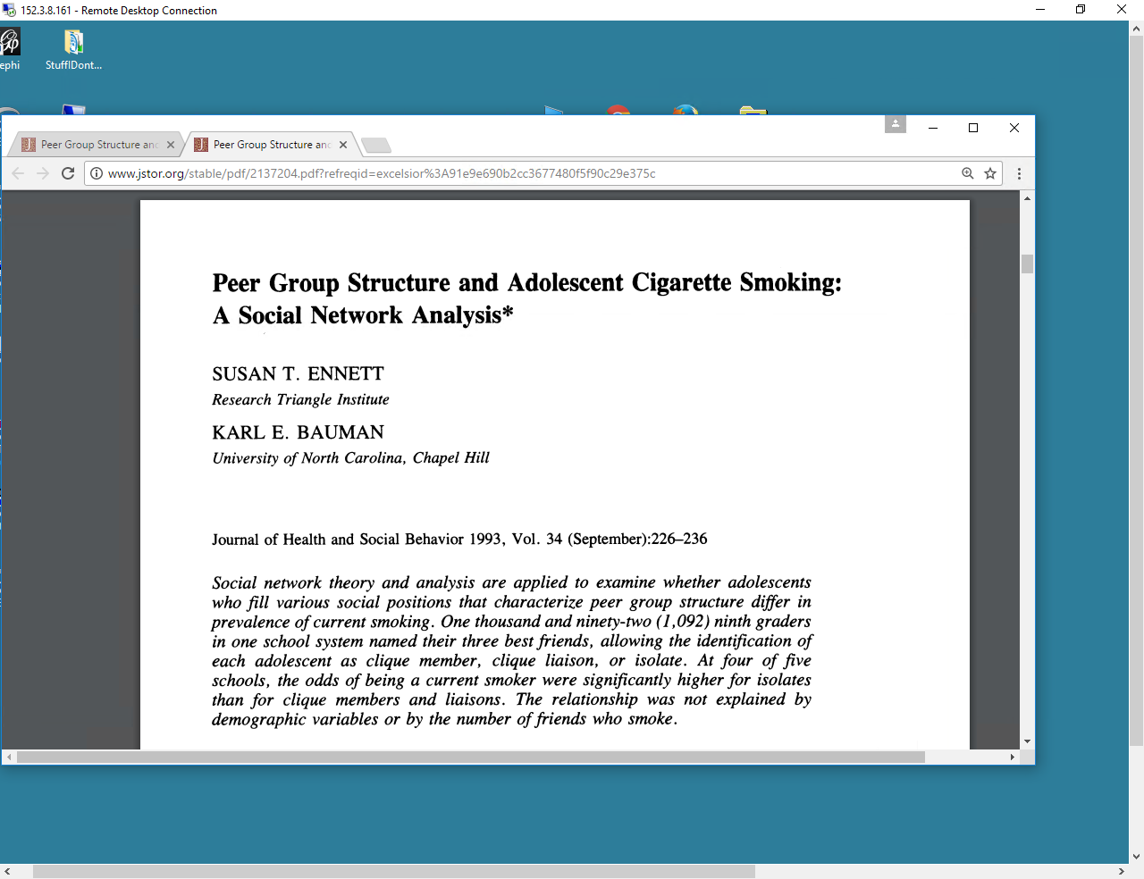
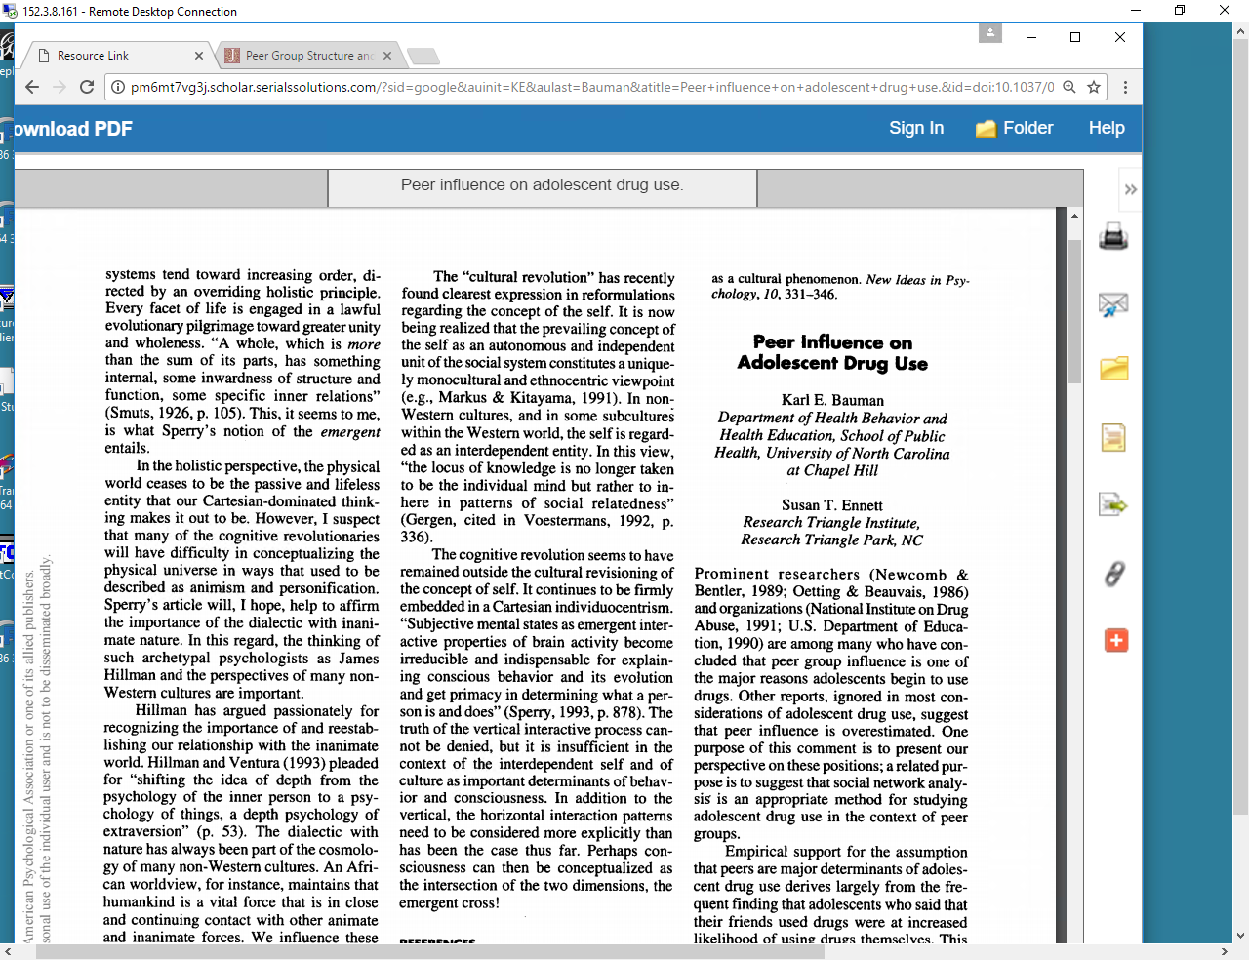

Slide 28


Slide 29

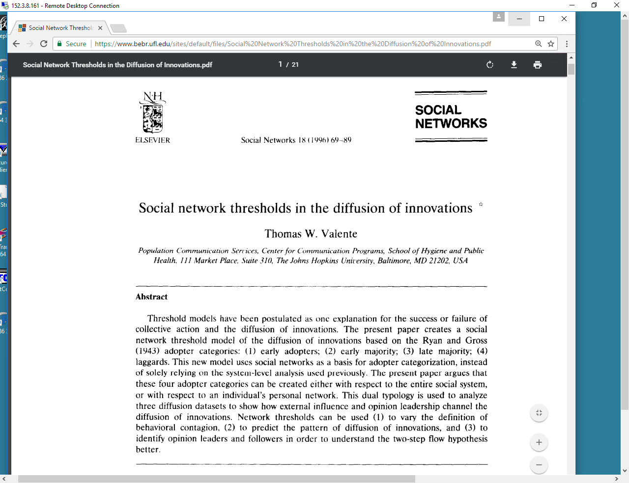
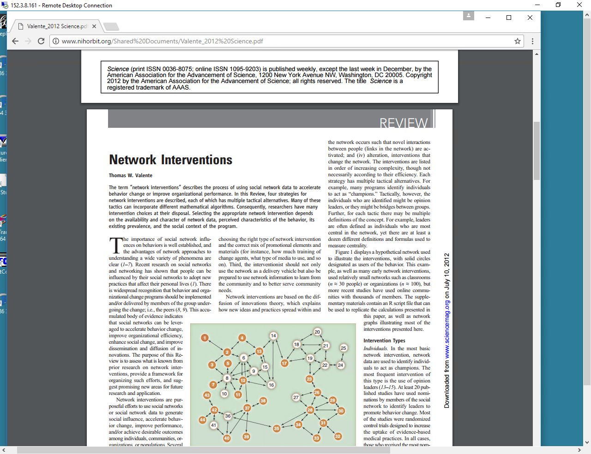
Social
Networks
Science

Slide 30

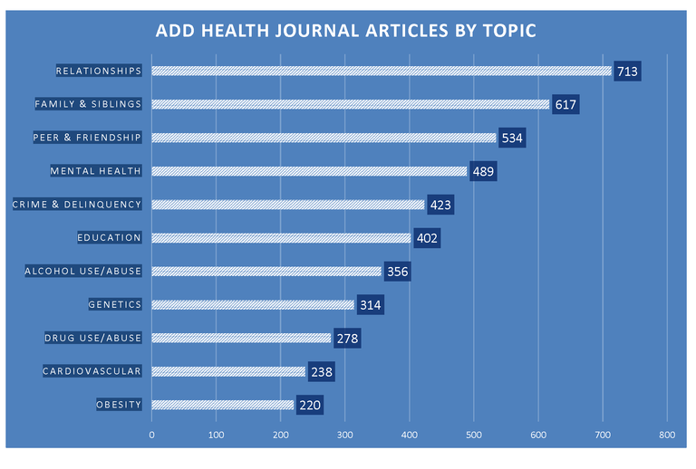

Slide 31
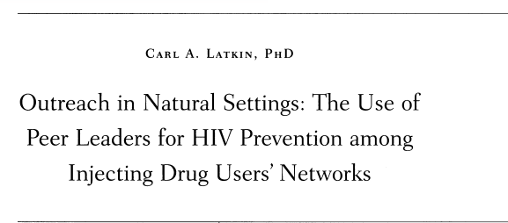
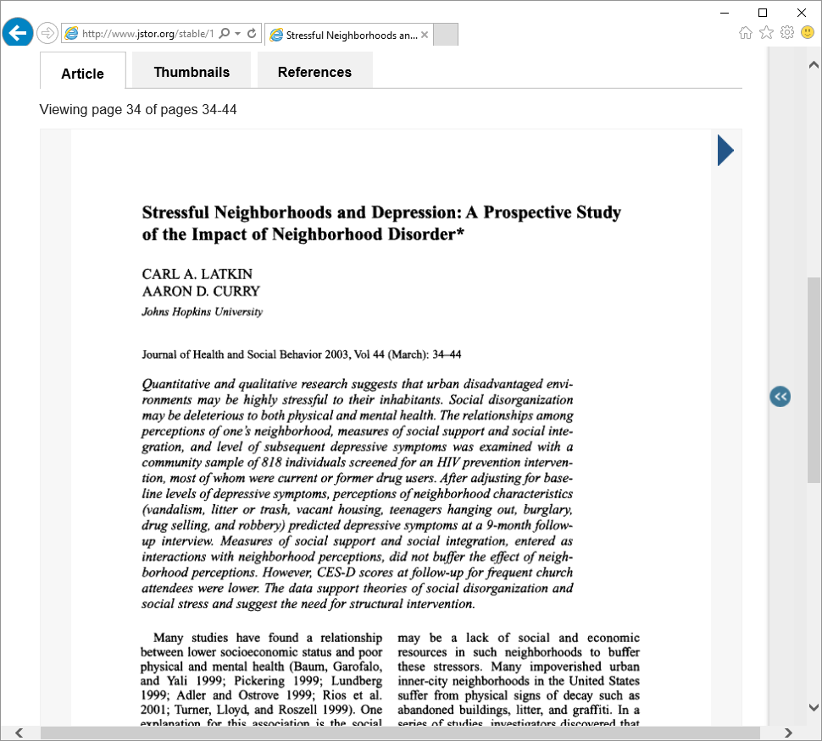
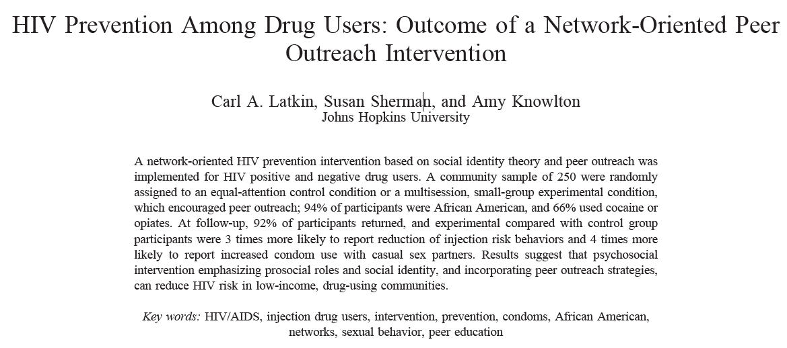

PUBLIC HEALTH REPORTS, 1998

Slide 32
Social Science & Medicine, 2000

Slide 33
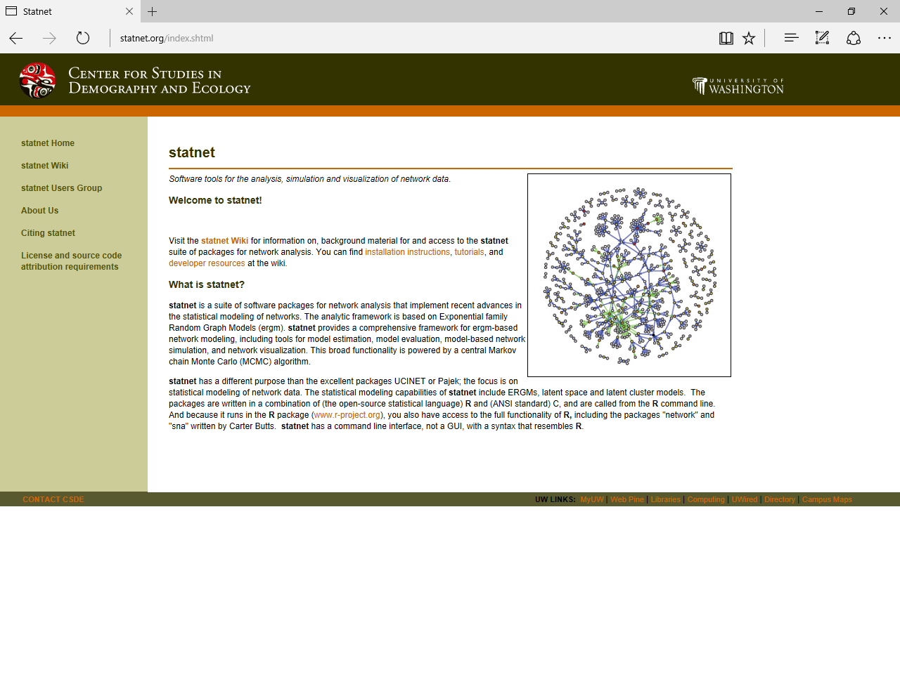
Mark S. Handcock, David R. Hunter, Carter T. Butts, Steven M. Goodreau, and Martina Morris (2003). statnet: Software tools for the Statistical Modeling of Network Data. URL http://statnetproject.org

Slide 34
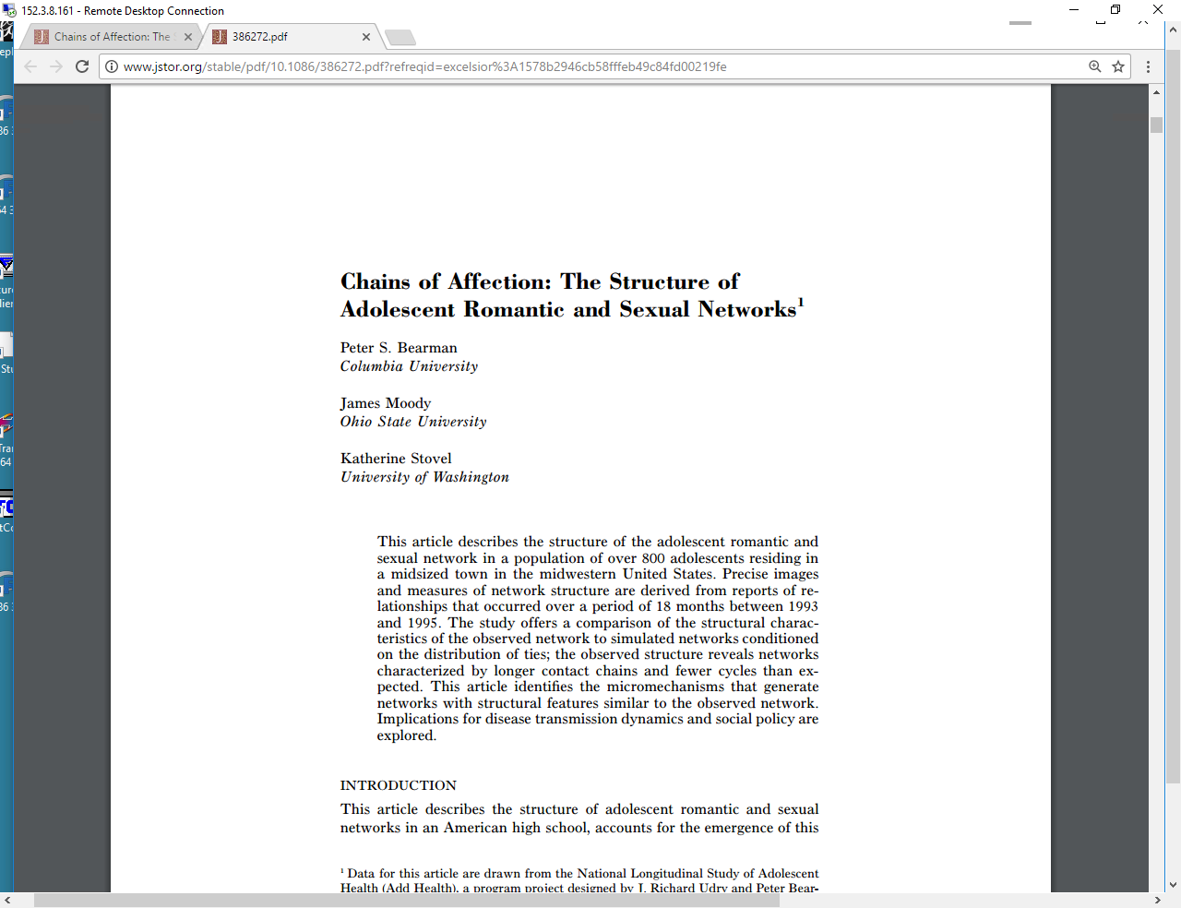
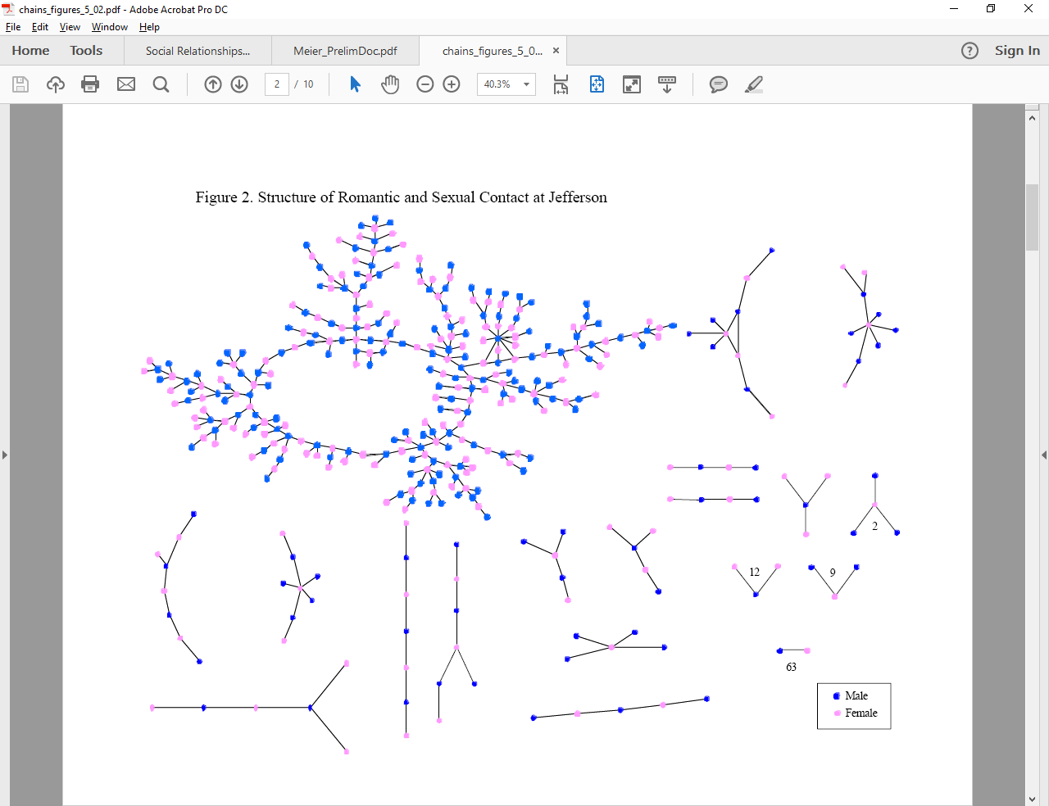

Slide 35
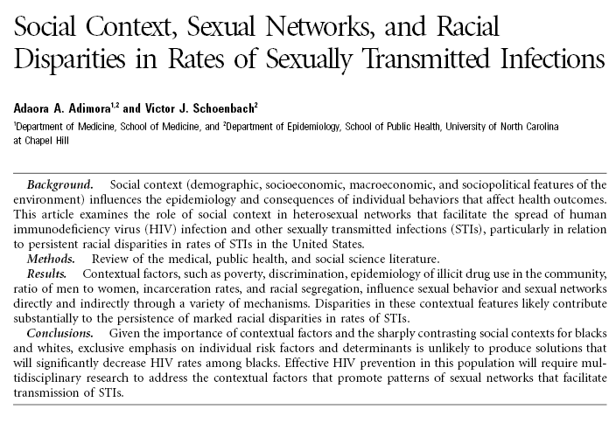

Slide 36


Slide 37


Slide 38


Slide 39
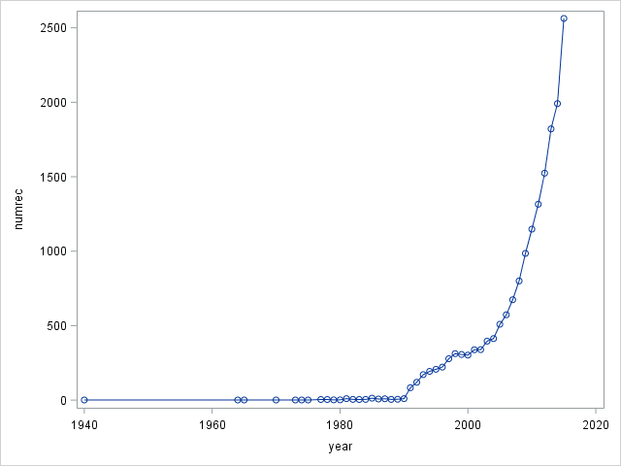
State of the field
Trends
English language Articles indexed in Web of Science Social Science Citation Index on: ("health" or "well being" or "medicine") and "network*").
There have been 18572 such papers since 2000.

Slide 40
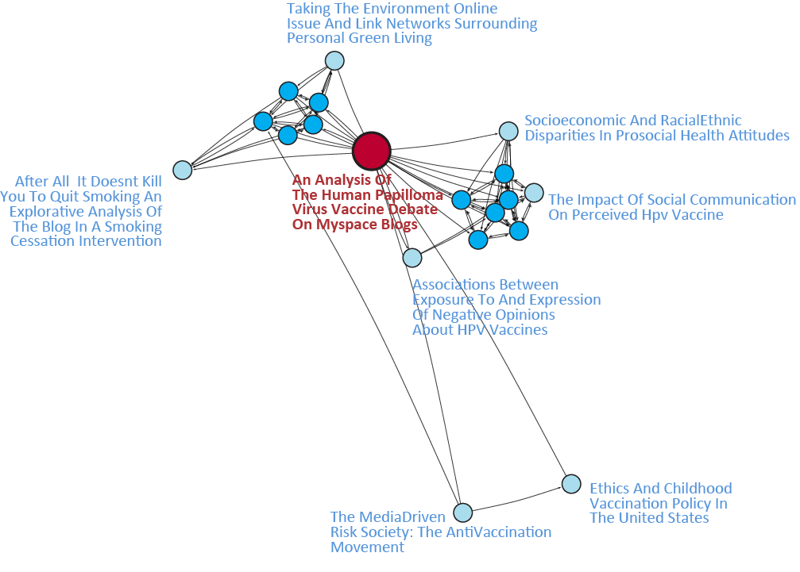
State of the field
Big-Picture
Bibliographic Similarity Networks: 1-step neighborhood of a single paper

Slide 41
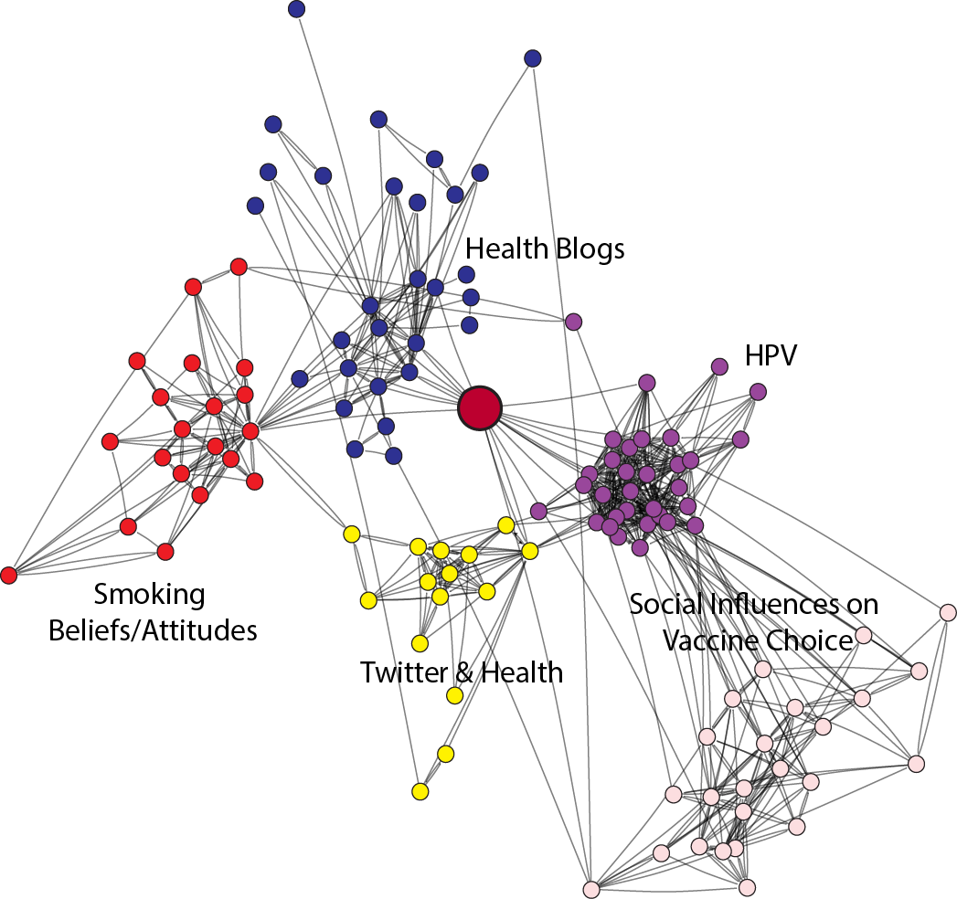
State of the field
Big-Picture
Bibliographic Similarity Networks: 2-step neighborhood of a single paper

Slide 42
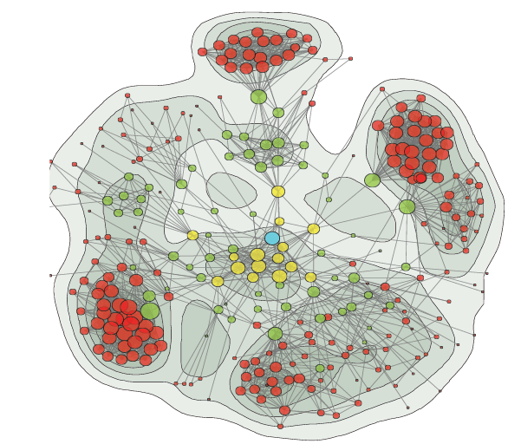
State of the field
Big-Picture
Since the net is large…
Use a force-directed layout to display the full space & overlay clusters….

Slide 43
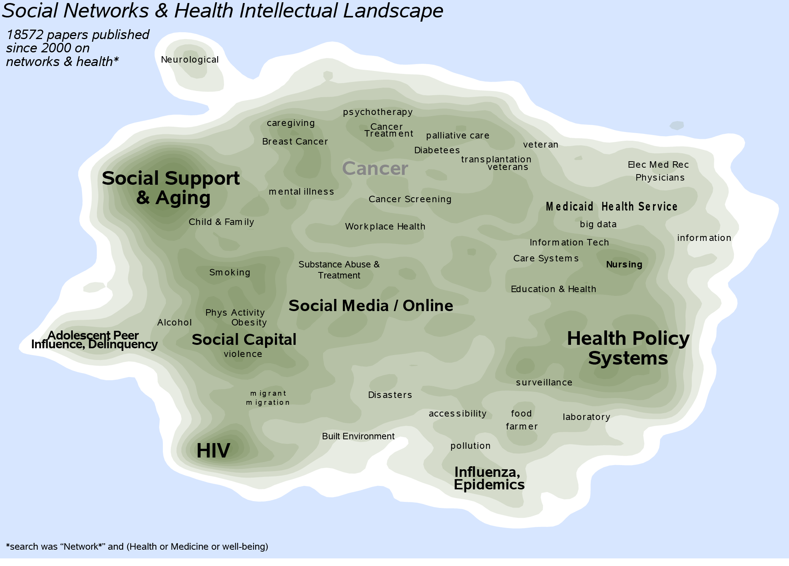
The example paper…

Slide 44
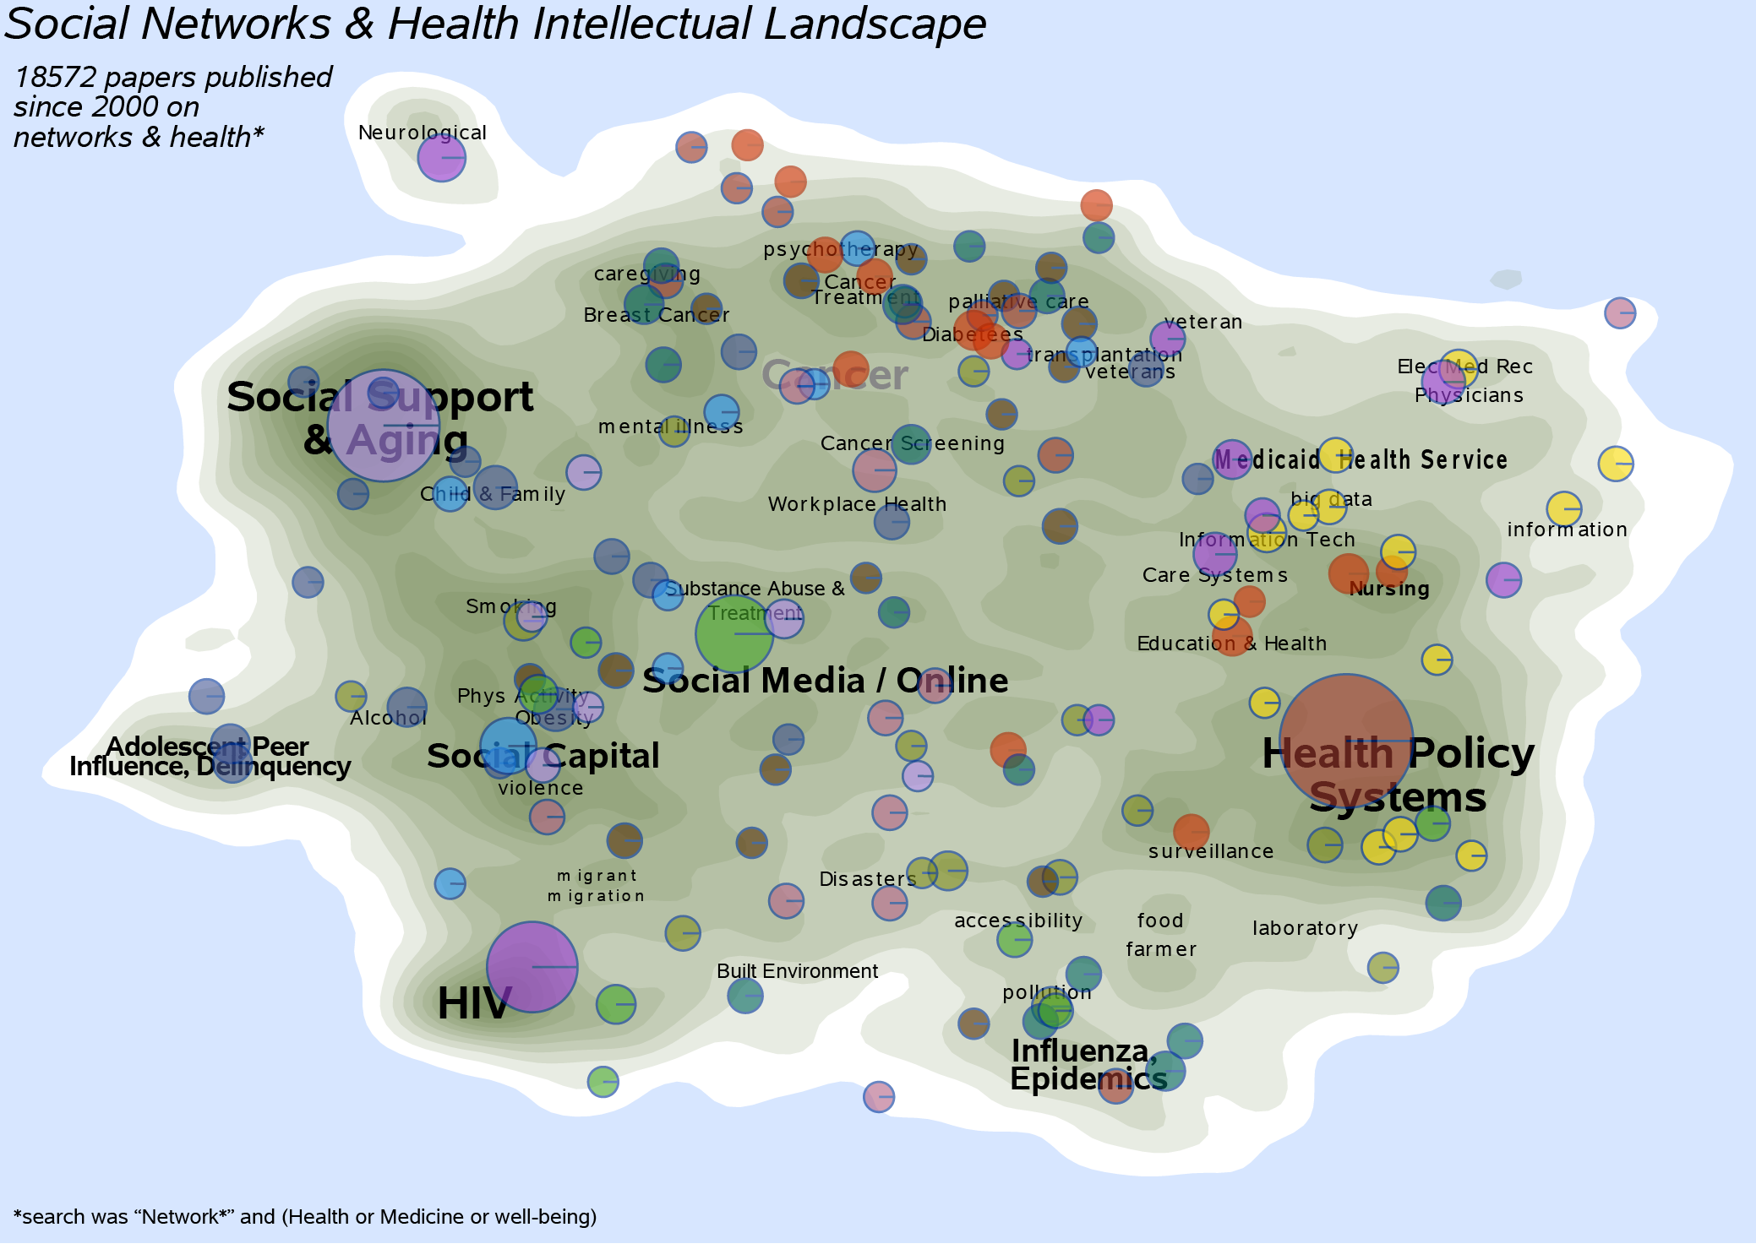
Modularity:
Top-Level: 0.798 @ 32 Clusters
2nd Level: 0.785 @ 150 Clusters

Slide 45
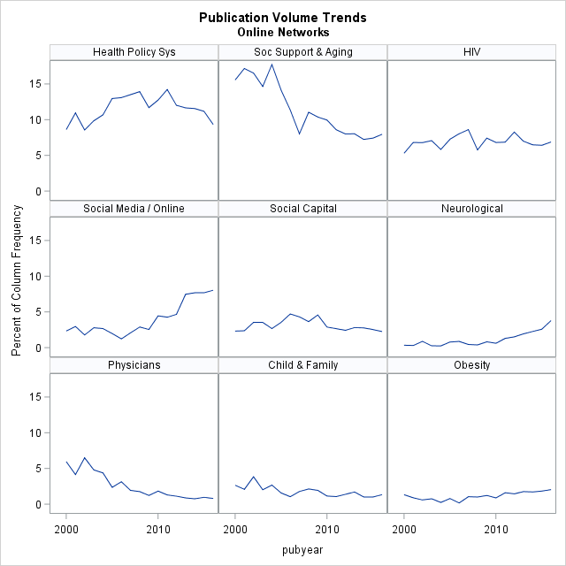

Slide 46
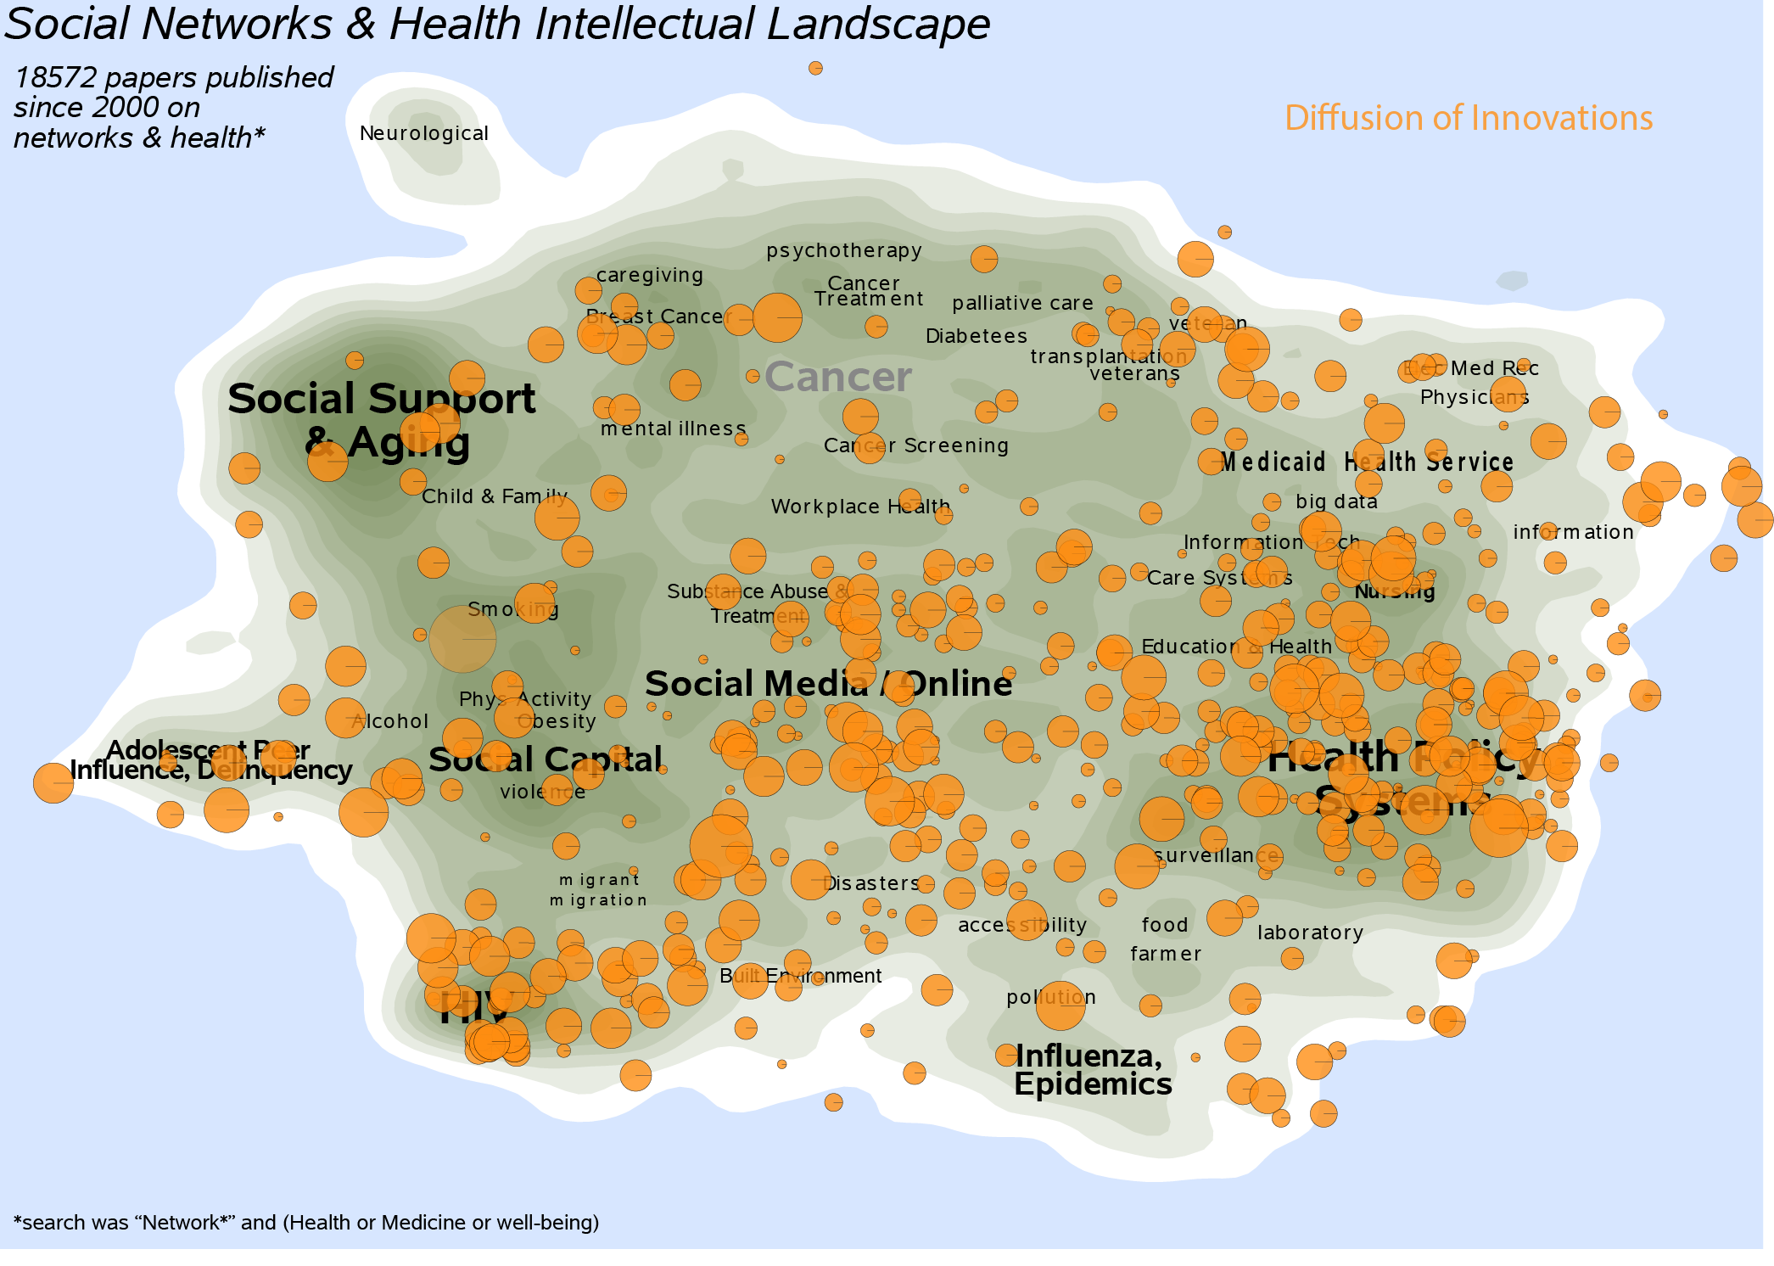
Rogers:

Slide 47
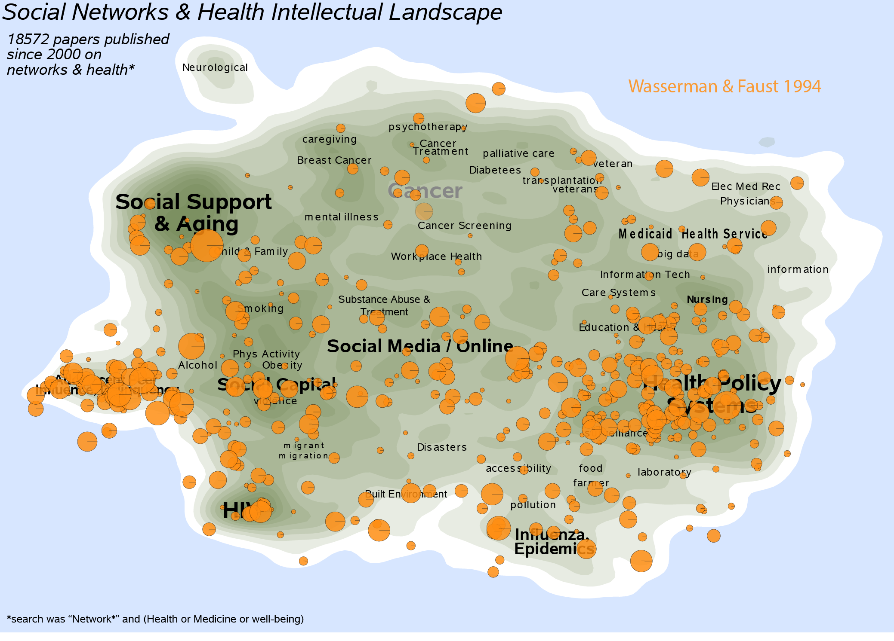

Slide 48
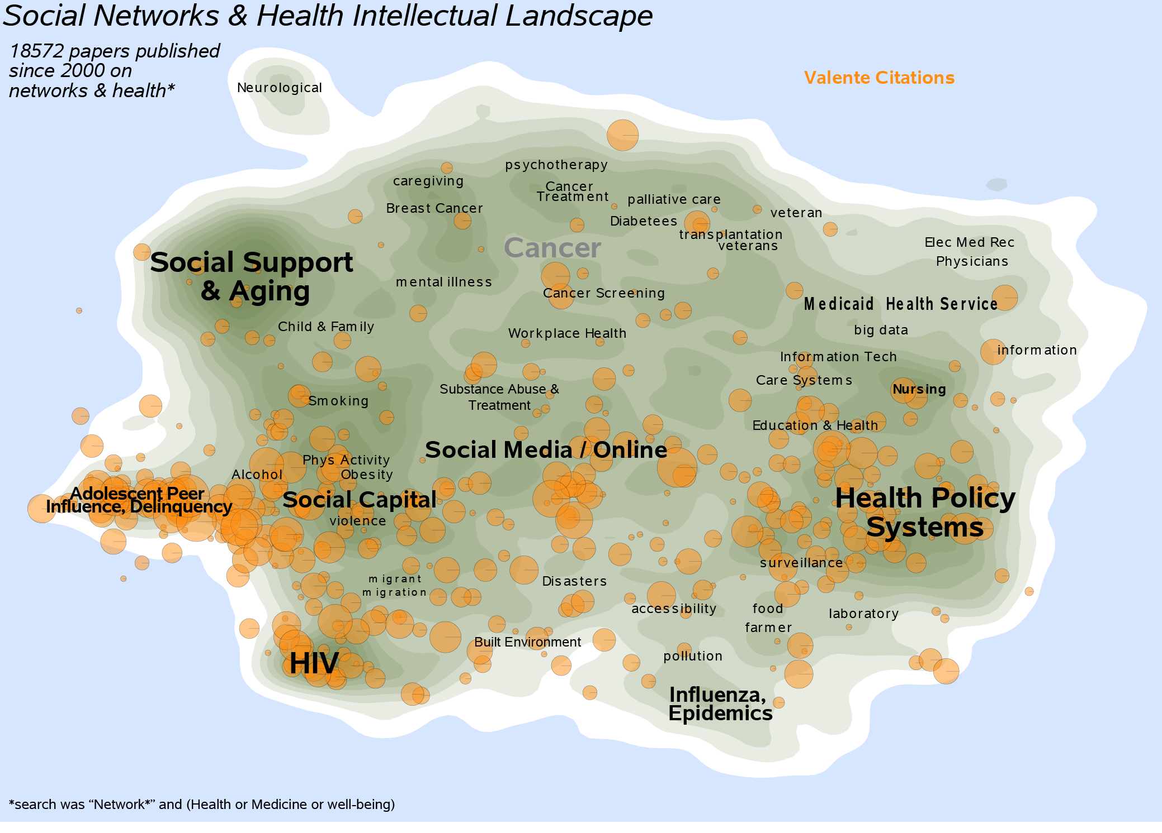
Valente: Various

Slide 49
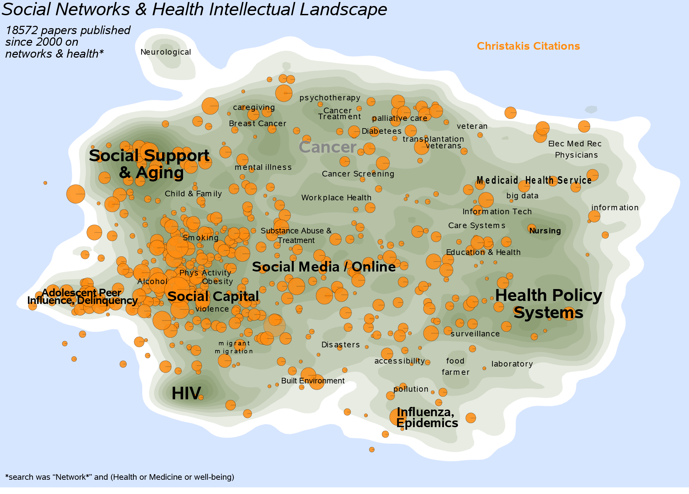
Christakis & Fowler

Slide 50
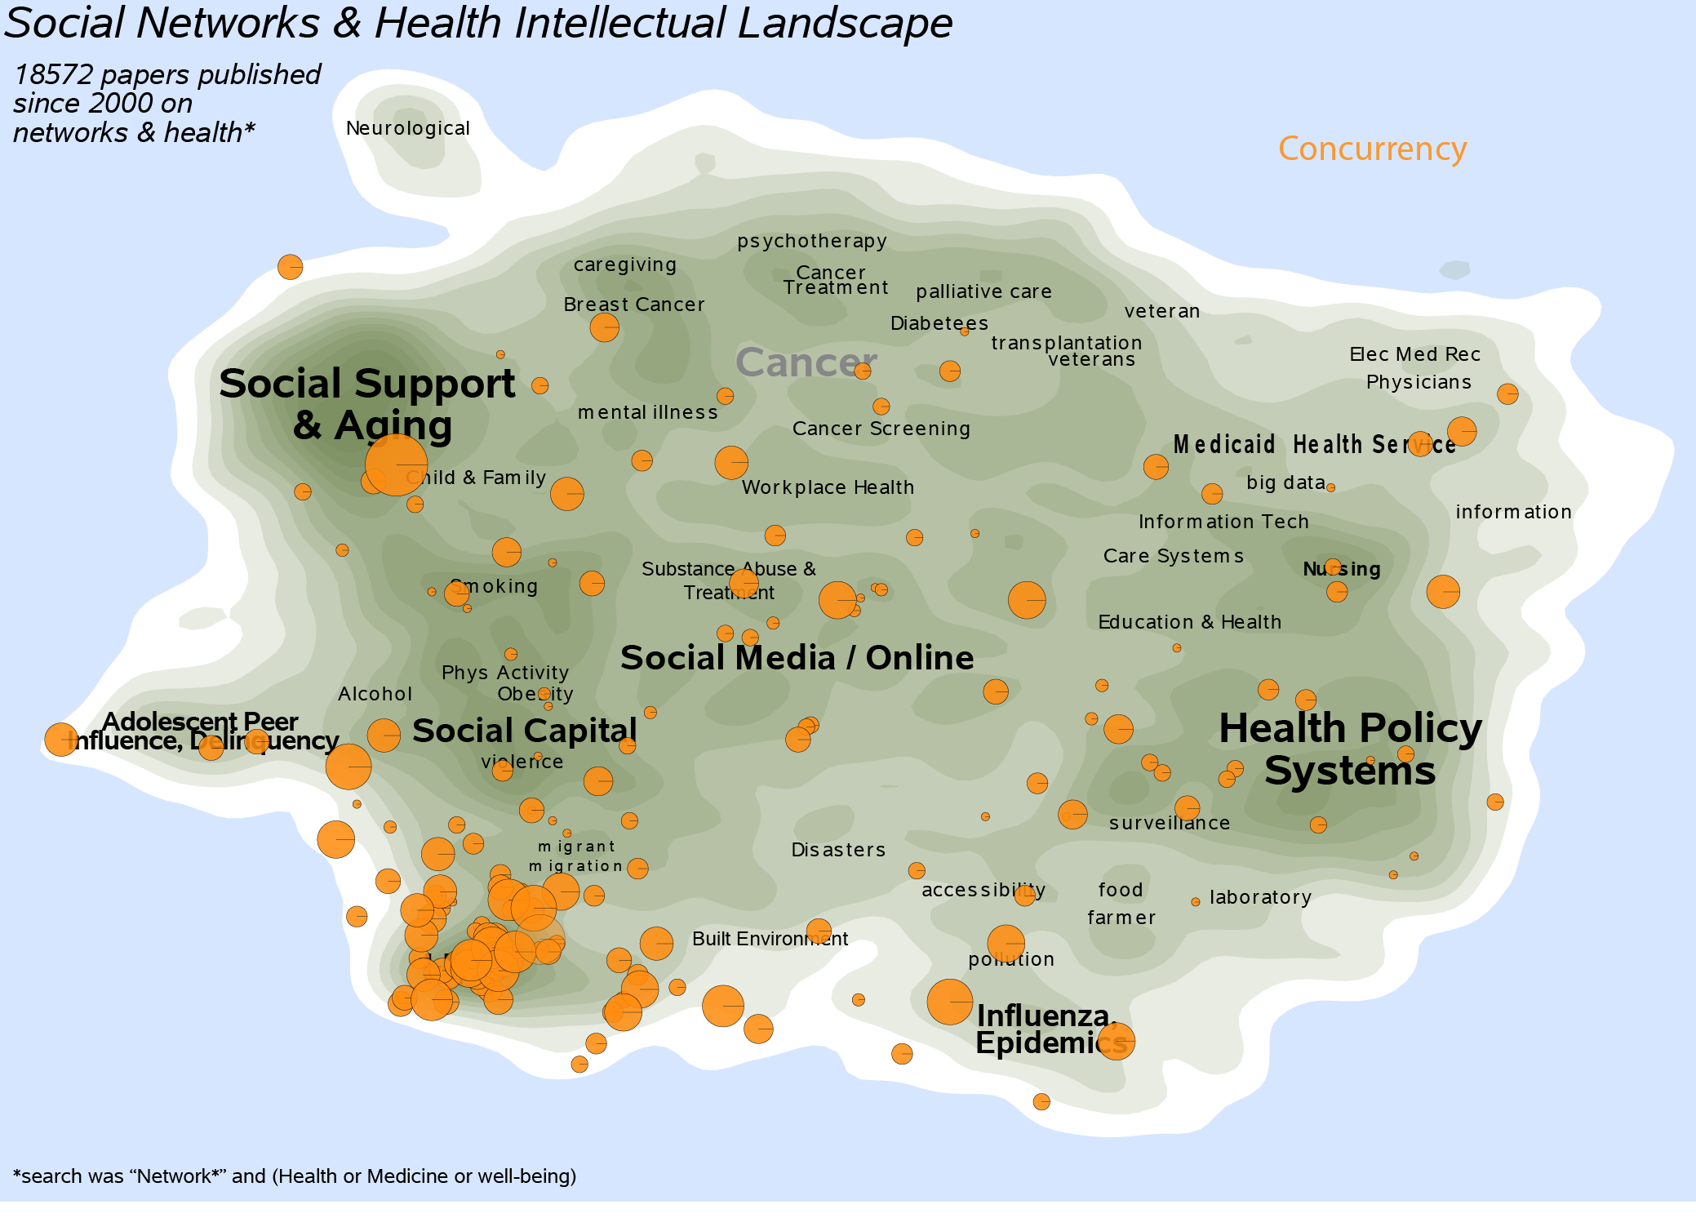
Martina Morris: Concurrency

Slide 51

Heckathorn: RDS

Slide 52

House: Social Relations & Health

Slide 53

Provan: Network Effectiveness

Slide 54

Add Health

Slide 55

Ellison et al: Facebook

Slide 56

Edward Laumann

Slide 57

Pescosolido

Slide 58


Slide 59


Slide 60


Slide 61

Introduction
Network Research Lifecycle

Slide 62
Introduction
Key Questions
Social Network analysis lets us answer questions about social interdependence. These include:
“Networks as Variables” approaches
Are kids with smoking peers more likely to smoke themselves?
Do unpopular kids get in more trouble than popular kids?
Do central actors control resources?
“Networks as Structures” approaches
What generates hierarchy in social relations?
What network patterns spread diseases most quickly?
How do role sets evolve out of consistent relational activity?
Both: Connectionist vs. Positional features of the network
We don’t want to draw this line too sharply: emergent role positions can affect individual outcomes in a ‘variable’ way, and variable approaches constrain relational activity.

Slide 63
Why do networks matter?
Two fundamental mechanisms: Problem space
Connectionist:
Positional:
Networks
As Cause
Networks
As Result
Diffusion
Peer influence
Social Capital
“small worlds”
Social integration
Peer selection
Homophily
Network robustness
Networks as pipes
Popularity Effects
Role Behavior
Network Constraint
Group stability
Network ecology
“Structuration”
Networks as roles
This rubric is organized around social mechanisms – the reasons why networks matter, which ends up being loosely correlated with specific types of measures, analysis, and data collection method.

Slide 64

X
Y
Why do networks matter?
Two fundamental mechanisms: Connections
C
P
Connectionist network mechanisms : Networks matter because of the things that flow through them. Networks as pipes.

Slide 65
X
Y
Why do networks matter?
Two fundamental mechanisms: Connections example
C
P
The spread of any epidemic depends on the number of secondary cases per infected case, known as the reproductive rate (R₀). R₀ depends on the probability that a contact will be infected over the duration of contact (β), the likelihood of contact (c), and the duration of infectiousness (D).
For network transmission problems, the trick is specifying c, which depends on the network.

Slide 66

X
Y
Why do networks matter?
Two fundamental mechanisms: Connections example
Isolated vision
C
P
Notes:
Consider the following example. Here we have sampled respondents (red dots) reporting on their interaction with romantic partners. A classic local network module would ask about their characteristics and behaviors, then attempt to relate those characteristics to ego’s behavior. All of these sampled nodes have the exact same number of partners.

Slide 67

X
Y
Why do networks matter?
C
Why do networks matter?
Two fundamental mechanisms: Connections example
Connected vision
P
Notes:
But these nodes are situated in dramatically different parts of the real underlying global network. Here some of them (lower left) are truly local isolates, but most are embedded in a larger network structure.
These are real data from Add Health, on romantic involvement.

Slide 68








X
Y
Connections: Diffusion
Example: Small local changes can create cohesion cascades
C
P
Emergent Connectivity in “low-degree” networks
Partner
Distribution
Component
Size/Shape
Based on work supported by R21-HD072810 (NICHD, Moody PI), R01 DA012831-05 (NIDA Morris, Martina PI)

Slide 69
X
Y
Why do networks matter?
Two fundamental mechanisms: Positions
C
P
Positional network mechanisms : Networks matter because of the way they capture role behavior and social exchange. Networks as Roles.
Romantic Love
Provides food for
Bickers with

Slide 70
X
Y
Why do networks matter?
Two fundamental mechanisms: Positions
C
P
Positional network mechanisms : Networks matter because of the way they capture role behavior and social exchange. Networks as Roles.
Parent
Parent
Child
Child
Child
Romantic Love
Provides food for
Bickers with

Slide 71
Social Network Data
The unit of interest in a network are the combined sets of actors and their relations.
We represent actors with points and relations with lines.
Actors are referred to variously as:
Nodes, vertices or points
Relations are referred to variously as:
Edges, Arcs, Lines, Ties
Example:
b
d
a
c
e

Slide 72
Social Network Data
In general, a relation can be:
Binary or Valued
Directed or Undirected
b
d
b
d
a
c
e
a
c
e
Undirected, binary
Directed, binary
b
d
b
d
1
3
1
2
a
c
4
e
a
c
e
Undirected, Valued
Directed, Valued

Slide 73
Social Network Data
Basic Data Elements
In general, a relation can be: (1) Binary or Valued (2) Directed or Undirected
b
d
a
c
e
Directed,
Multiplex categorical edges
The social process of interest will often determine what form your data take. Conceptually, almost all of the techniques and measures we describe can be generalized across data format, but you may have to do some of the coding work yourself….

Slide 74
Social Network Data
Basic Data Elements: Levels of analysis
We can examine networks across multiple levels:
1) Ego-network
- Have data on a respondent (ego) and the people they are connected to (alters). Example: 1985 GSS module
- May include estimates of connections among alters
2) Partial network
- Ego networks plus some amount of tracing to reach contacts of contacts
- Something less than full account of connections among all pairs of actors in the relevant population
- Example: CDC Contact tracing data for STDs

Slide 75
Social Network Data
Basic Data Elements: Levels of analysis
We can examine networks across multiple levels:
3) Complete or “Global” data
- Data on all actors within a particular (relevant) boundary
- Never exactly complete (due to missing data), but boundaries are set
Example: Coauthorship data among all writers in the social sciences, friendships among all students in a classroom

Slide 76
Social Network Data
Basic Data Elements: Levels of analysis
Global-Net
Primary
Group
Ego-Net
Best Friend
Dyad
2-step
Partial network

Slide 77
Social Network Data
Social network data are substantively divided by the number of modes in the data.
1-mode data represents edges based on direct contact between actors in the network. All the nodes are of the same type (people, organization, ideas, etc). Examples:Communication, friendship, giving orders, sending email.
This is commonly what people think about when thinking about networks: nodes having direct relations with each other.

Slide 78
Social Network Data
Social network data are substantively divided by the number of modes in the data.
2-mode data represents nodes from two separate classes, where all ties are across classes. Examples:
People as members of groups
People as authors on papers
Words used often by people
Events in the life history of people
The two modes of the data represent a duality: you can project the data as people connected to people through joint membership in a group, or groups to each other through common membership
There may be multiple relations of multiple types connecting your nodes.

Slide 79

Social Network Data
Basic Data Elements: Modes
Bipartite networks imply a constraint on the mixing, such that ties only cross classes.
Here we see a tie connecting each woman with the party she attended (Davis data)

Slide 80

Social Network Data
Basic Data Elements: Modes
Bipartite networks imply a constraint on the mixing, such that ties only cross classes.
Here we see a tie connecting each woman with the party she attended (Davis data)

Slide 81

Social Network Data
Basic Data Elements: Modes
By projecting the data, one can look at the shared between people or the common memberships in groups: this is the person-to-person projection of the 2-mode data.

Slide 82

Social Network Data
Basic Data Elements: Modes
By projecting the data, one can look at the shared between people or the common memberships in groups: this is the group-to-group projection of the 2-mode data.

Slide 83

Social Network Data
Example of a 2-mode network: faculty supervising students
- Any list of what people do – meetings, clubs, activities, co-authorship, – that they do with others forms network data.
Moody

Slide 84





Social Network Data
Example of a 2-mode network: Patients & Care Settings
The Movement of Carbapenem-Resistant Klebsiella pneumoniae among Healthcare Facilities: A Network Analysis
D van Duin, F Perez, E Cober, SS Richter, RC Kalayjian, RA Salata, N Scalera, R Watkins, Y Doi, S Evans, VG Fowler Jr, KS Kaye, SD Rudin, KM Hujer, AM Hujer,
RA Bonomo, and J Moody for the Antibacterial Resistance Leadership Group

Slide 85


Social Network Data
Example of a 2-mode network: Patients & Care Settings
Casalino, Lawrence P., Michael F. Pesko, Andrew M. Ryan, David J. Nyweide, Theodore J. Iwashyna, Xuming Sun, Jayme Mendelsohn and James Moody. “Physician Networks and Ambulatory Care Admissions” Medical Care 53:534-41
Notes:
"ambulatory care sensitive conditions" (ACSCs). ACSCs are conditions for which good outpatient care can potentially prevent the need for hospitalization, or for which early intervention can prevent complications or more severe disease. These are conditions for which good primary care may prevent admission. We used 12 conditions that met the AHRQ definition.
We examined fixed effects for each PPC, controlling for patient and physician characteristics. PPC fixed effects were jointly significant in the model at P < 0.01, suggesting that PPCs are associated with ACSA rates. The differences in performance were substantial. For example, compared to a mean number of ACSAs of 0.060 per beneficiary per year for all PPCs, the PPC at the 25th percentile of ACSA rates had 0.050 ACSAs per beneficiary, whereas the PPC at the 75th percentile had a 46% higher ACSA rate—0.073 per beneficiary
(data not shown).
On average, ACSA rates differed by 36% between PPCs that admit to the same hospital.

Slide 86
Social Network Data
Basic Data Structures
From pictures to matrices
b
d
The traditional way to store & represent network data is with an adjacency matrix.
The matrix (X) at right represents an undirected binary network. Each node (a-e) is listed on both the row and the column.
The i^{th} row and the j^{th} column (X_{ij}) records the value of a tie from node i to node j. For example, the line between nodes a and b is represented as an entry in the first row and second column (red at right).
Because the graph is undirected the ties sent are the same as the ties receive, so every entry above the diagonal equals the entries below the diagonal.
a
c
e
Undirected, binary
a
b
c
d
e
a
1
b
1
1
c
1
1
1
d
1
1
e
1
1
An undirected graph and the corresponding matrix is symmetric.

Slide 87
Social Network Data
Basic Data Structures
b
d
Directed graphs, on the other hand, are asymmetrical.
We can see that X_{ab} =1 and X_{ba} =1, therefore a “sends” to b and b “sends” to a. However, X_{bc}=0 while X_{cb}=1; therefore, c “sends” to b, but b does not reciprocate.
a
c
e
Directed, binary
a
b
c
d
e
a
1
b
1
c
1
1
1
d
e
1
1
A directed graph and the corresponding matrix is asymmetrical.

Slide 88
Social Network Data
Basic Data Structures
b
d
Directed graphs, on the other hand, are asymmetrical.
We can see that X_{ab} =1 and X_{ba} =1, therefore a “sends” to b and b “sends” to a. However, X_{bc}=0 while X_{cb}=1; therefore, c “sends” to b, but b does not reciprocate.
a
c
e
Directed, Valued
a
b
c
d
e
a
1
b
3
c
1
2
4
d
e
2
1
A directed graph and the corresponding matrix is asymmetrical.

Slide 89
Social Network Data
Basic Data Structures
From matrices to lists (binary)
Social network analysts also use adjacency lists and arc lists to more efficiently store network data.
Arc List
a b
b a
b c
c b
c d
c e
d c
d e
e c
e d
a
b
c
d
e
Adjacency List
a
1
b
d
a b
b a c
c b d e
d c e
e c d
b
1
1
a
c
e
c
1
1
1
d
1
1
e
1
1
Notes:
Notice that the adjacency list states that a is tied to b and b is tied to a and c. The arc list merely lists all of the tied nodes or relationships.

Slide 90
Social Network Data
Basic Data Structures
From matrices to lists (valued)
Social network analysts also use adjacency lists and arc lists to more efficiently store network data.
Arc List
a b 1
b a 1
b c 2
c b 2
c d 3
c e 5
d c 3
d e 1
e c 5
e d 1
a
b
c
d
e
Adjacency List
a
1
contact
value
1
b
2
3
d
1
a b
b a c
c b d e
d c e
e c d
a 1
b 1 2
c 2 3 1
d 3 1
e 5 1
b
1
2
a
c
5
e
c
2
3
5
d
3
1
e
5
1
Notes:
Notice that the adjacency list states that a is tied to b and b is tied to a and c. The arc list merely lists all of the tied nodes or relationships.

Slide 91
Social Network Data
Basic Data Structures
Working with two-mode data
A person-to-group adjacency matrix is rectangular, with one mode (persons, say) down rows and the other (groups, say) across columns
Each column is a group, each row a person, and the cell = 1 if the person in that row belongs to that group.
You can tell how many groups two people both belong to by comparing the rows: Identify every place that both rows = 1, sum them, and you have the overlap.
1 2 3 4 5
A 0 0 0 0 1
B 1 0 0 0 0
C 1 1 0 0 0
D 0 1 1 1 1
E 0 0 1 0 0
F 0 0 1 1 0
A =

Slide 92
Social Network Data
Basic Data Structures
Working with two-mode data
Compare persons A and F:
Person A is in 1 group, Person F is in two groups, and they are in no groups together.
1 2 3 4 5
A 0 0 0 0 1
B 1 0 0 0 0
C 1 1 0 0 0
D 0 1 1 1 1
E 0 0 1 0 0
F 0 0 1 1 0
1 2 3 4 5 Σ
A 0 0 0 0 1 = 1
F 0 0 1 1 0 = 2
AF 0 0 0 0 0 = 0
A =
Or persons D and F:
Person D is in 4 groups, Person F is in two groups, and they are in 2 groups together.
1 2 3 4 5 Σ
D 0 1 1 1 1 = 4
F 0 0 1 1 0 = 4
DF 0 0 1 1 0 = 2

Slide 93
Social Network Data
Basic Data Structures
Working with two-mode data
Similarly for Groups:
1 2 3 4 5
A 0 0 0 0 1
B 1 0 0 0 0
C 1 1 0 0 0
D 0 1 1 1 1
E 0 0 1 0 0
F 0 0 1 1 0
1 2 1•2
A 0 0 0
B 1 0 0
C 1 1 1
D 0 1 0
E 0 0 0
F 0 0 0
Σ 2 2 1
Group 1 has 2 members, group 2 has 2 members and they overlap by 1 members (C).
A =

Slide 94
Social Network Data
Basic Data Structures
Working with two-mode data
In general, you can get the overlap for any pair of groups / persons by summing the multiplied elements of the corresponding rows/columns of the persons-to-groups adjacency matrix. That is:
Persons-to-Persons
Groups-to-Groups

Slide 95
Social Network Data
Basic Data Structures
Working with two-mode data
One can get either projection easily with a little matrix multiplication. First define A^{T} as the transpose of A (simply reverse the rows and columns). If A is of size P x G, then A^{T} will be of size G x P.
1 2 3 4 5
A 0 0 0 0 1
B 1 0 0 0 0
C 1 1 0 0 0
D 0 1 1 1 1
E 0 0 1 0 0
F 0 0 1 1 0
A B C D E F
1 0 1 1 0 0 0
2 0 0 1 1 0 0
3 0 0 0 1 1 1
4 0 0 0 1 0 1
5 1 0 0 1 0 0
A^{T} =
A =

Slide 96
Social Network Data
Basic Data Structures
1 2 3 4 5
A 0 0 0 0 1
B 1 0 0 0 0
C 1 1 0 0 0
D 0 1 1 1 1
E 0 0 1 0 0
F 0 0 1 1 0
A B C D E F
1 0 1 1 0 0 0
2 0 0 1 1 0 0
3 0 0 0 1 1 1
4 0 0 0 1 0 1
5 1 0 0 1 0 0
A =
A^{T} =
(6x5)
(5x6)
P = A(A^{T})
G = A^{T}(A)
A * A^{T} = P
(6x5)(5x6) (6x6)
A^{T} * A = P
(5x6) 6x5) (5x5)
P
A B C D E F
A 1 0 0 1 0 0
B 0 1 1 0 0 0
C 0 1 2 1 0 0
D 1 0 1 4 1 2
E 0 0 0 1 1 1
F 0 0 0 2 1 2
G
1 2 3 4 5
1 2 1 0 0 0
2 1 2 1 1 1
3 0 1 3 2 1
4 0 1 2 2 1
5 0 1 1 1 2

Slide 97

SN&H Program
Overview

Slide 98
SN&H Program
Overview

Slide 99
SN&H Program
Overview

Slide 100
SN&H Program
Overview

Slide 101
SN&H Program
Overview

Slide 102
SN&H Program
Overview

Slide 103
SN&H Program
Overview

Slide 104
SN&H Program
Overview

Slide 105

SN&H Program
Who are you?

Slide 106
SN&H Program
Thanks to DuPRI, DNAC Staff, SSRI, NICHD

